Slide 1


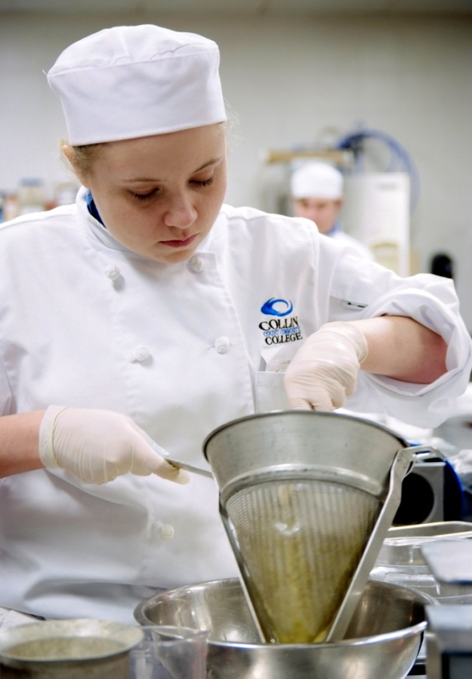
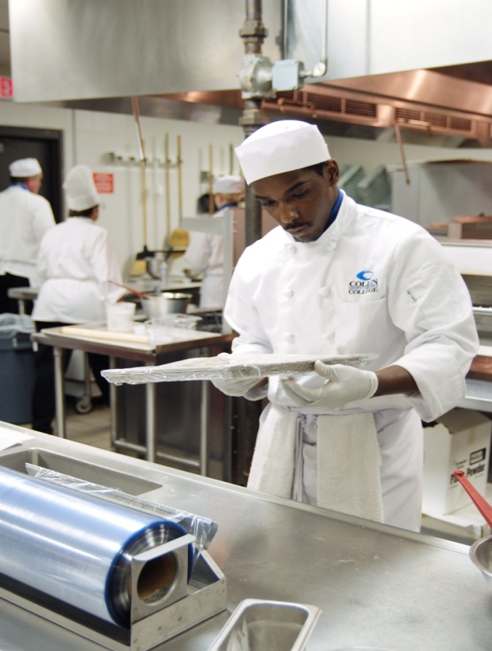
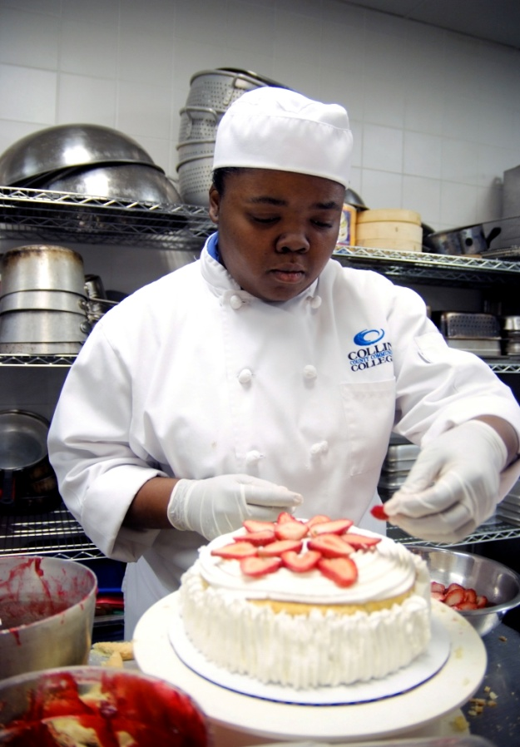
Welcome to
Collin’s Culinary & Pastry Arts
Student Orientation

Slide 2

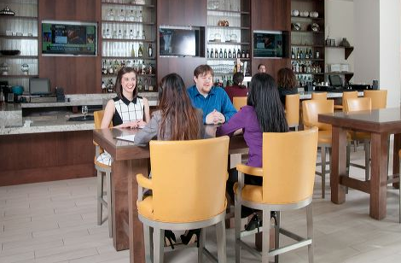
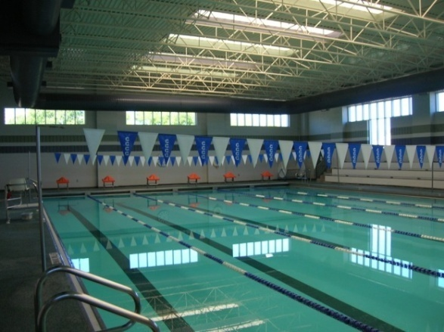
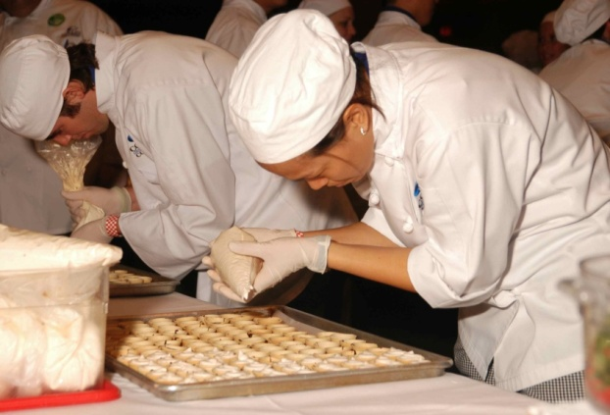
Program History
Lodging Management- 1997
Culinary Arts AAS- 1999
Pastry Arts AAS- 2009

Slide 3
IHCE Mission Statement
The Institute of Hospitality & Culinary Education (IHCE) prepares students for the demands of the fast-paced hospitality and foodservice industry. We are committed to developing skills, strengthening character and work ethic, and challenging the student’s intellectual and creative curiosity.

Slide 4
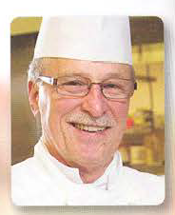
Culinary/Pastry Faculty
Chef Tom Severs
Professor of Culinary Arts
A.O.S Culinary Arts
-Culinary Institute of America
Office: PRC - A154
Phone: 972-377-1773
TSevers@collin.edu

Slide 5
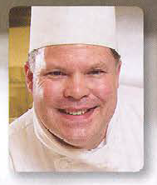
Culinary/Pastry Faculty
Chef Thomas Nixon
Professor of Culinary Arts
A.A.S. Food and Hospitality Service
-El Centro College
Office: PRC - A155
Phone: 972-377-1752
TNixon@collin.edu

Slide 6
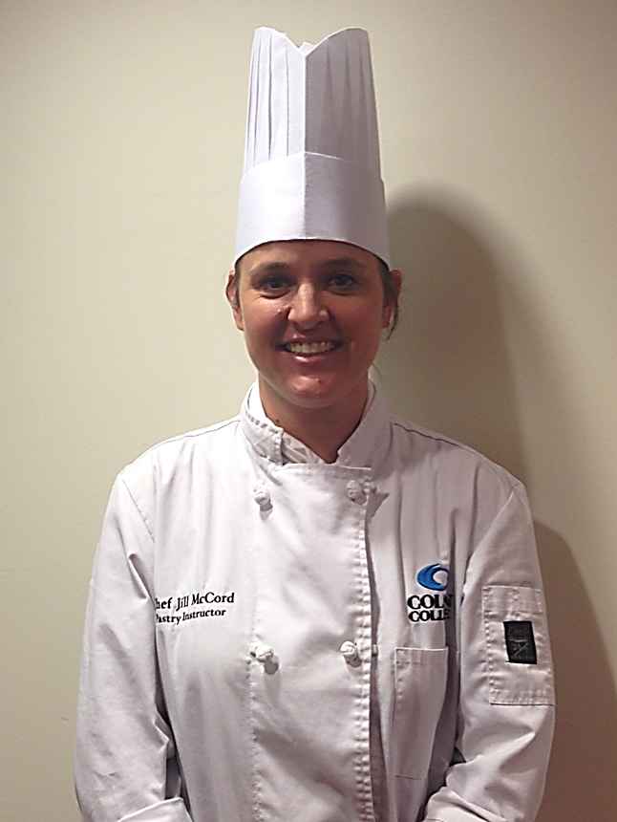
Culinary/Pastry Faculty
Chef Jill McCord
Professor of Pastry Arts
B.S. Health Education
- Eastern Illinois University, Illinois
A.S. Baking & Pastry
- Lincoln Culinary Institute, Florida
Office: A105
Phone: 972-377-1057
JMcCord@collin.edu

Slide 7
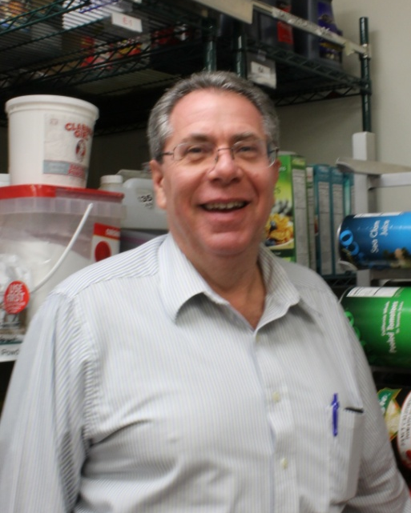
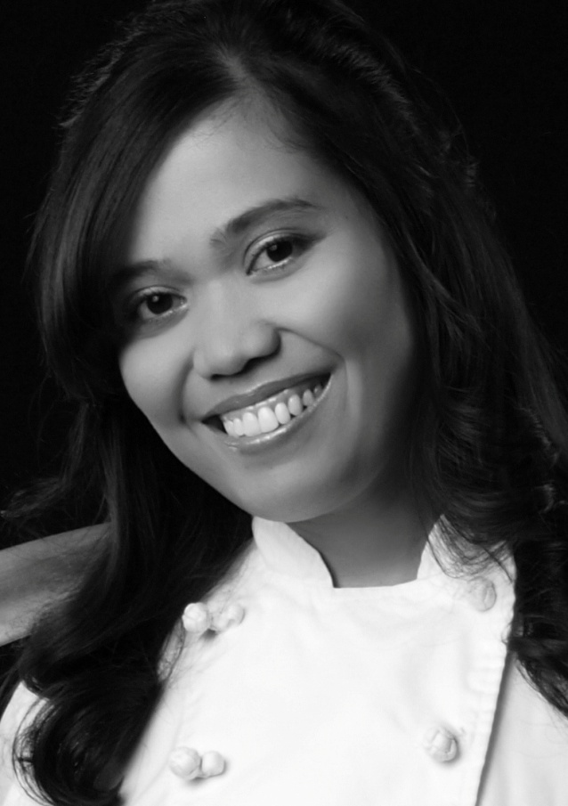
John Hines
Culinary/ Pastry Staff
Karen Martin
Culinary Lab Coordinator
-Manages kitchen labs & procures food ingredients
Office: PRC - A156
Phone: 972-377-1068
JHines@collin.edu
Culinary Lab Assistant
- Manages food ingredients room
Office: PRC- A157
Phone: 972-377-1084
KBMartin@collin.edu

Slide 8
Your Program Academic Advisor
John Guillory
Academic Planning Consultant
Office: PRC- F-109
Phone: 972 -377-1521
JGuillory@collin.edu

Slide 9
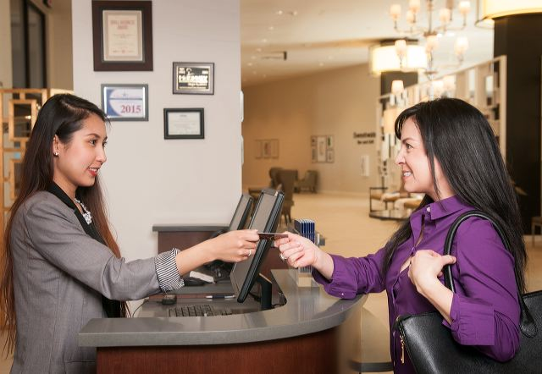
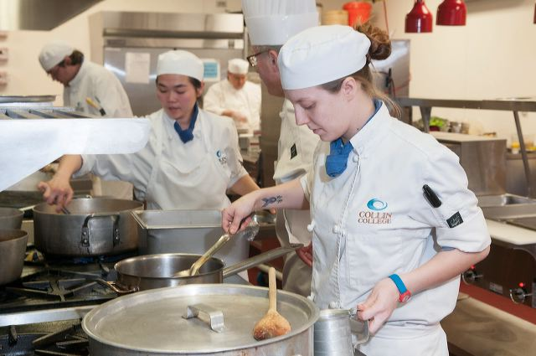
IHCE Program
Degree Programs:
Hospitality & Foodservice Management
  Hotel & Restaurant Management Track
  Meetings & Event Management Track
AAS Degree
60 credit hours
Culinary Arts or Pastry Arts
  AAS Degree
60 credit hours

Slide 10




Articulation Agreements
  1. Texas Woman’s University
*BAS - Culinary Science & Food Service Management
* Research Chef Association (RCA) approved Culinology program designation
  2. Conrad N. Hilton – University of Houston
  3. Business & Hotel Management School- Switzerland
  4. Texas Tech University

Slide 11


Articulation Agreements
5. Tarleton State University
(Member of the Texas A & M University System)
6. Texas A&M University Commerce

Slide 12

ACF Accredited Program
AAS Culinary Arts = CC (certified culinarian)
AAS Pastry Arts = CPC (certified pastry culinarian)
  ACF membership
  Submit transcripts

Slide 13
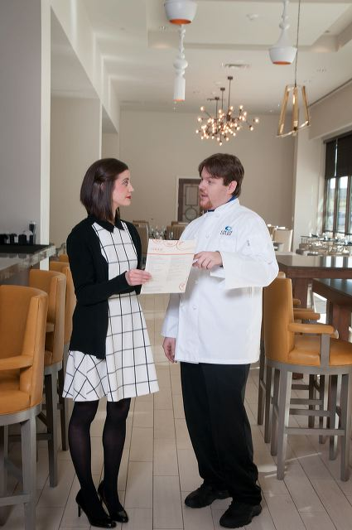
Certificate Programs:
IHCE Program
Hotel/Restaurant Management Certificate
27 credit hours
Meetings/Event Management Certificate
24 credit hours
Culinary Arts Certificate
24 credit hours
Advanced Culinary Arts Certificate
12 credit hours
Pastry Arts Certificate
24 credit hours
Advanced Pastry Arts Certificate
12 credit hours

Slide 14
Cost of Degrees
AAS Culinary Arts – 60 credit hours
In County - Culinary Arts AAS Total: | $ 5,135.00
Out of County - Culinary Arts AAS Total: | $ 7,595.00
Out of State - Culinary Arts AAS Total: | $ 11,195.00
AAS Pastry Arts- 60 credit hours
In County - Pastry Arts AAS Total: | $ 5,260.00
Out of County - Pastry Arts AAS Total: | $ 7,720.00
Out of State - Pastry Arts AAS Total: | $ 11,320.00

Slide 15
Cost of Certificates
Certificate- Culinary Arts – 24 credit hours
In County - Culinary Arts Certificate Total: | $ 2,249.00
Out of County - Culinary Arts Certificate Total: | $ 3,233.00
Out of State - Culinary Arts Certificate Total: | $ 4,673.00
Certificate- Pastry Arts- 24 credit hours
In County - Pastry Arts Certificate Total: | $ 2,469.00
Out of County - Pastry Arts Certificate Total: | $ 3,453.00
Out of State - Pastry Arts Certificate Total: | $ 4,893.00

Slide 16
Cost of Certificates
Certificate- Advanced Culinary Arts – 12 credit hours
In County – Advanced Culinary Arts Certificate Total: | $ 1,412.00
Out of County – Advanced Culinary Arts Certificate Total: | $ 1,904.00
Out of State – Advanced Culinary Arts Certificate Total: | $ 2,624.00
Certificate- Advanced Pastry Arts – 12 credit hours
In County – Advanced Pastry Certificate Total: | $ 1,412.00
Out of County – Advanced Pastry Arts Certificate Total: | $ 2,016.00
Out of State – Advanced Pastry Arts Certificate Total: | $ 3,540.00

Slide 17
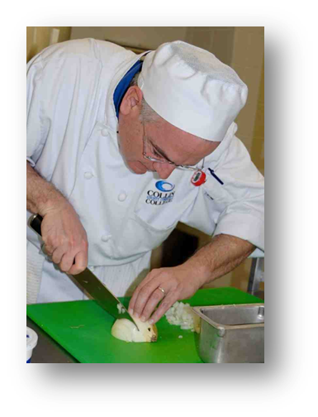
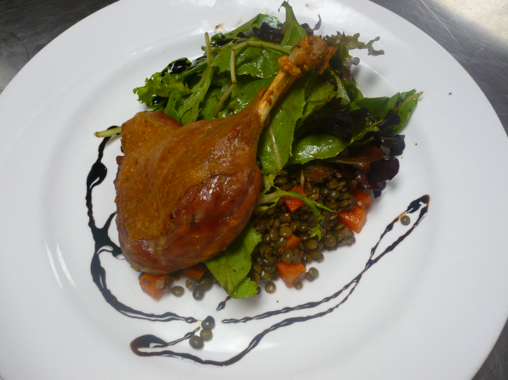
What does it take to be a chef?
Well rounded education in
techniques,
curiosity and dedication to craft!

Slide 18



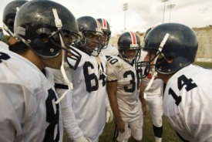
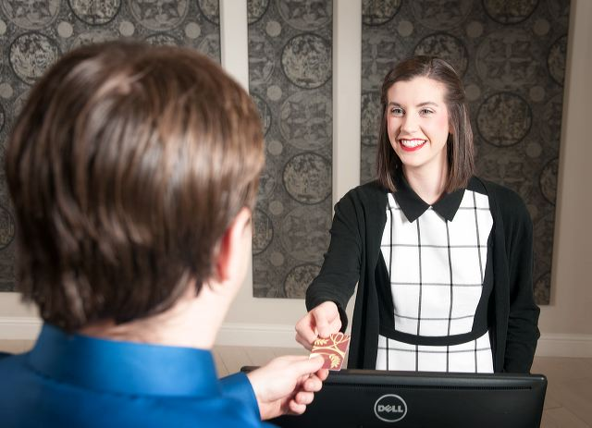
What does it require from you?
Commitment
Determination & Perseverance
Professionalism
Willingness to work in a team

Slide 19
Required Supplies for Class
For Culinary, Pastry, & Hotel/Restaurant Students
1. Uniform
2. Tool Kits and supplies
3. Books

Slide 20
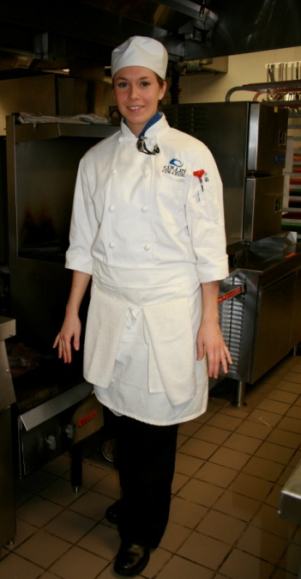
1. Full Uniform
"A Chef's professional pride can be extended to personal appearance and behavior in and around the kitchen"
IMPORTANT: You must be in full uniform the first day of your CHEF 1301,PSTR 1301, and/or RSTO 2307 class.
Neckerchief
(color depends on major)
Chef Beanie
White Double- Breast Chef Coat with Collin logo
White Side Towels
Plain Black Pants
White Apron
Black rubber soled shoes with black/white socks

Slide 21
1. Full Uniform continued…
Chef’s beanie hat - $12
Neckerchief – approx. $8.00 (depending on colors)
  blue for culinary
  black for pastry
  white w/blue stripe for hotel/restaurant
White double-breasted chef’s jacket ~with Collin logo Approx. $25-30 (depends on size)
…all prices are subject to change without notice

Slide 22
1. Full Uniform continued…
Black chef pants $25-$30 (depends on size)
White Utility apron $8
White Side towels - $1.50 each
Black leather non-slip shoes –must have a back; kitchen only
Plain white tee shirt only
White/Black cotton socks – tube sock
“It takes years to become a chef. It only takes minutes to look like one!”

Slide 23
2. Tool Kits and Supplies for both culinary and pastry
Knife Kit sold in bookstore includes:
  8” Chef’s Knife
  3.5” Paring Knife
  3.5” Shaping knife
  6” Boning Knife
  10” Serrated Knife/Bread Knife
  12” Sharpening/Honing Steel
  3 Knife Sheaths
  Knife Roll/Bag
Grand Total = $ 157
1 Fish Spatula- ($17.20) optional
Note: Not required for Hotel/Restaurant Students

Slide 24
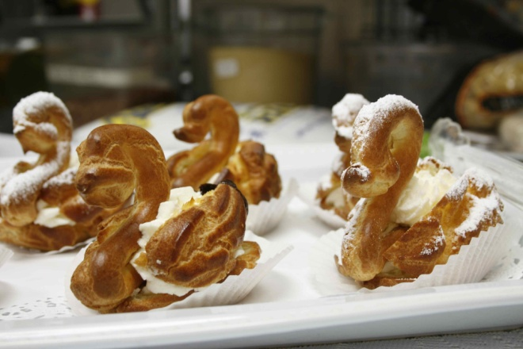
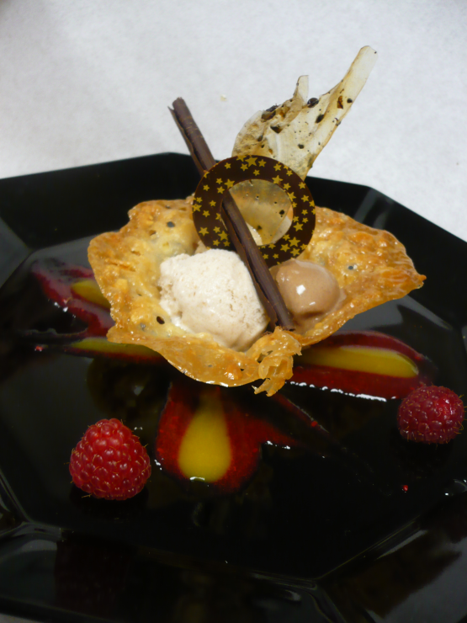
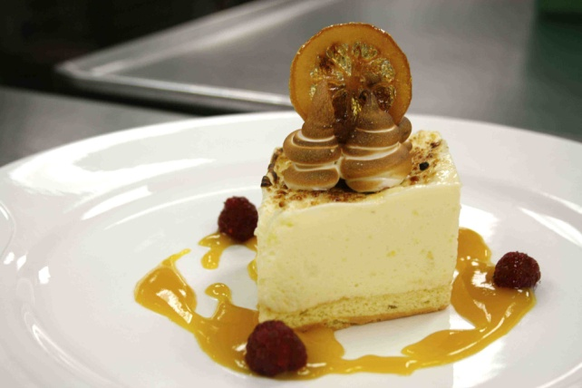
For both Culinary and Pastry
1 each Digital Thermometer- $18
6 each White Side Towels - $1.33 each
1 set Measuring Spoons -$ 5
1 each Peeler-$ 8
Heat resistant Spatula- $ 15
14” Wire Whisk- $ 12
Tongs- $13
Hair nets- $0.25
Beard Guards- $0.05
Note: Not required for Hotel/Restaurant Students

Slide 25
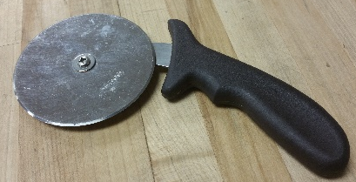
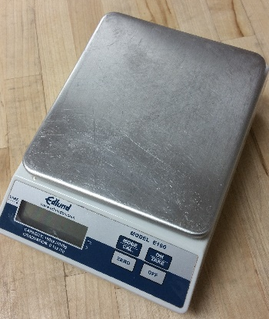
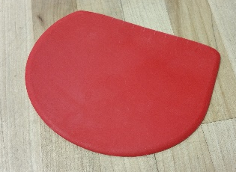
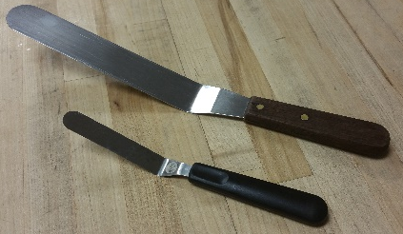
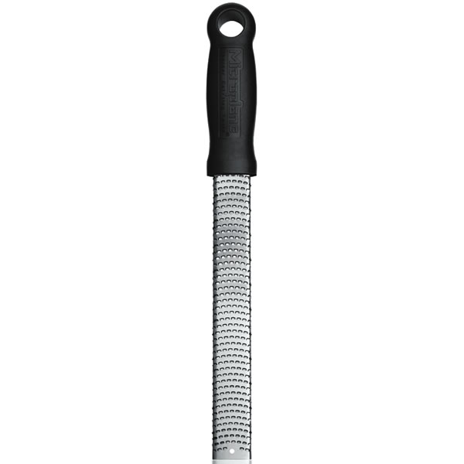
Additional Pastry Tools :
1. Pizza Cutter-$10
2. Digital Scale (oz/grams)- $70
3. Plastic Scraper- $3
Pallete Knife – 4.5”- $5 & 8”spatula- $15
5. Micro plane- $17.00
Note: Not required for Hotel/Restaurant Students

Slide 26
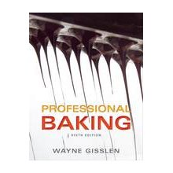
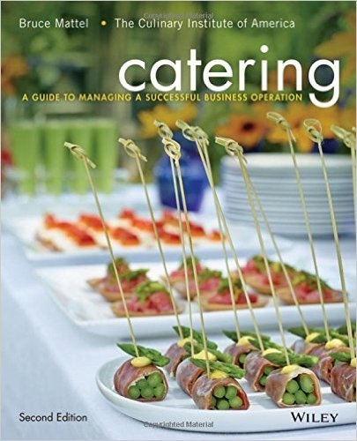
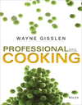
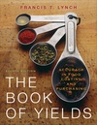
3. Text Books for Class
PASTRY PSTR 1301
CULINARY CHEF 1301
CATERING RSTO 2307
Fundamentals of Baking
Professional Baking
Wayne Gisslen:, 2012,
6th Ed. $132
Basic Food Preparation Professional Cooking - $155
Wayne Gisslen:, 2014, 8th Ed.
The Book of Yields: - $55 Accuracy in Food Costing and Purchasing
Francis T. Lynch, 2010 8th Ed.
Catering Management
Catering: A Guide to Managing a Successful Business Operation
Bruce Mattel, 2016,2nd Ed. approx. $50
…all prices are subject to change without notice

Slide 27
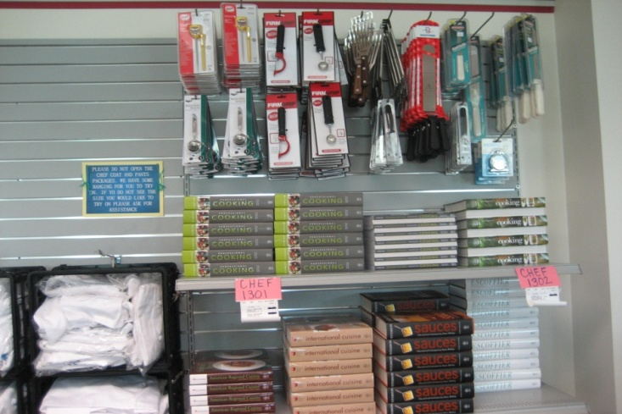
Required uniform items, knife, tool kits and books are available at
PRC bookstore
If they are out of stock, instructor will give you the names of reputable suppliers

Slide 28
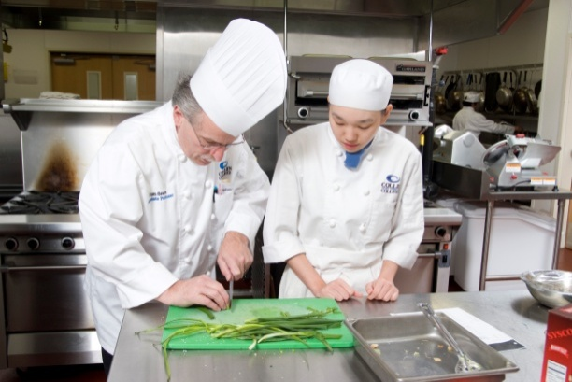
Outline of Typical Culinary/
Pastry Arts Class
Student arrives to lecture on time and having check their cougar email account
Students must be in full uniform in classroom and in the kitchen
Be prepared to start class with:
  Notebook
  Textbook
  4x6 index cards
  Pocket note book
  Pens/pencils/black Sharpie marker
  Class handouts
  Calculator

Slide 29
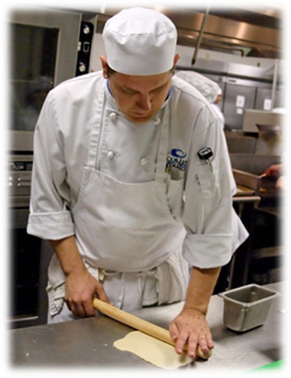
Outline of Typical Culinary/
Pastry Arts Class
Hands on cooking/baking lab in either:
  A151 - Advanced Food Prep Kitchen
  A152 - Skills/Stock Kitchen
  A153 - Baking and Pastry Kitchen
  Food tasting & critique
Kitchen clean up

Slide 30
Kitchen Protocol
Full uniform must be worn in the Culinary Arts Kitchen and Bakery. Students will not be permitted to enter class without full uniform. Uniforms are not required for lecture classes such as Sanitation and Safety
Uniform must be clean and wrinkle free. Students will not be permitted to enter class otherwise. It is advisable to bring along an extra apron to class.
Make-up should be worn sparingly. No false eyelashes.
Finger nails should be clean and short. Absolutely no nail polish or fake nails.
Jewelry should be limited to a metal wedding band. No earrings or other visible piercings.
All male students should be clean-shaven daily. Sideburns should be clipped one inch above the earlobes.
Beard guard needs to be
worn over any facial stubble

Slide 31
Kitchen Protocol cont.
Your hair should not touch your collar. Hair should be either kept very short or pulled under your chef’s hat using a hair net.
No chewing gum, drinking or eating (other than taste testing) is permitted in the Culinary Arts Kitchen or Bakery.
No running or horseplay.
No cell phone usage in the culinary labs this is a violation of the student code of conduct.
No food shall leave the Institute for Hospitality & Culinary Arts facility. All food prepared during class time must be consumed during class time.
No personal effects in the kitchen, purses, coats etc. Lockers are provided; students will need to bring their own locks for their lockers. Lockers must be vacated daily.

Slide 32
Kitchen Protocol cont.
Attendance is extremely important for all classes. Most classes will build off the previous class to develop skills and cooking methodologies. This is the time to start building a strong work ethic, which will aid in your success as a Professional Chef. Three absences will equal an automatic final grade of “F”.
Classes cannot be made up!
If you are late for class, it is at the discretion of the instructor whether or not you will be admitted to class and credited with attendance for that day.
Each student is graded daily on the five following categories:
  Use of tools, knives, equipment
  Mise-en-place
  Presentation of finished product
  Sanitation
  Class participation/responsibility
If you are not in class you will not receive a grade!

Slide 33
Grade Standards
CHEF 1305 Sanitation & Safety
  A final grade of “C” or higher to move past CHEF 1301 & PSTR 1301
CHEF 1301 Basic Food Preparation
  A final grade of “C” or higher to move into more advanced culinary classes
PSTR 1301 Fundamentals of Baking
  A final grade of “C” or higher to move into more advanced pastry classes

Slide 34
Degree Course Sequence
AAS Culinary
  CHEF 1301
  CHEF 1305
  HAMG 1321
  IFWA 1310
  CHEF 2331
  CHEF 1341
  RSTO 1325
  CHEF 1310
  CHEF 1345
  HAMG 1324
  PSTR 1301
  CHEF 2380
  Elective
  CHEF 1314/RSTO 1304
  (CAPSTONE)
AAS Pastry
  CHEF 1301
  CHEF 1305
  HAMG 1321
  PSTR 1301
  HAMG 1324
  IFWA 1310
  PSTR 1305
  RSTO 1325
  PSTR 1306
  PSTR 1310
  PSTR 2307
  PSTR 2301
  PSTR 2380
  Elective
  PSTR 2331 (CAPSTONE)
Note: Does not include AAS General Education (Gen. Ed)
Core classes. Gen. Ed. classes may be scheduled as needed.

Slide 35
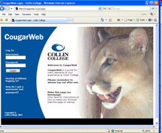

Communications
CougarWeb and
Cougar Mail
Facebook
https://www.facebook.com/CollinCollegeHospitality

Slide 36
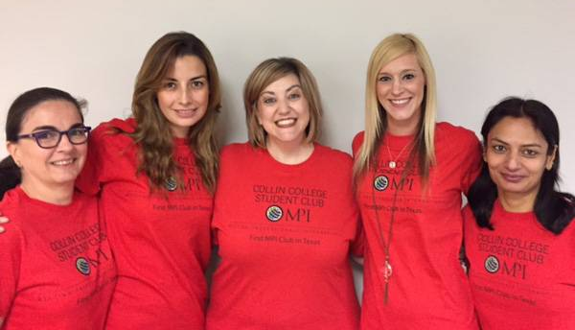

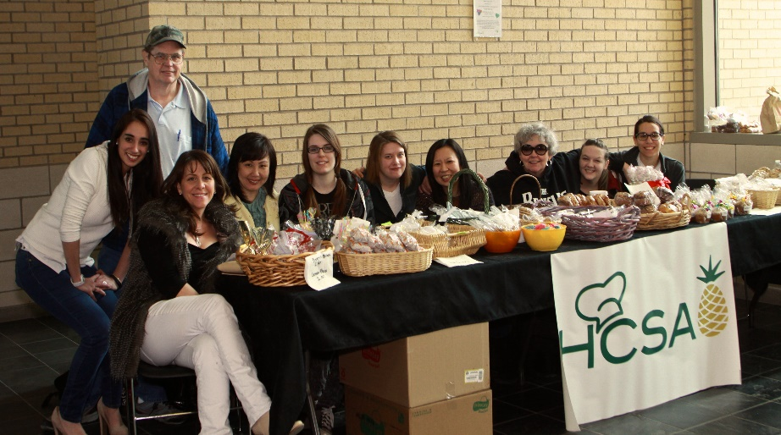

Student Organizations
Student run organization
Enrich your college experience!!!
Get involved - become
an officer or member
It’s absolutely free!
Follow us on Facebook

Slide 37
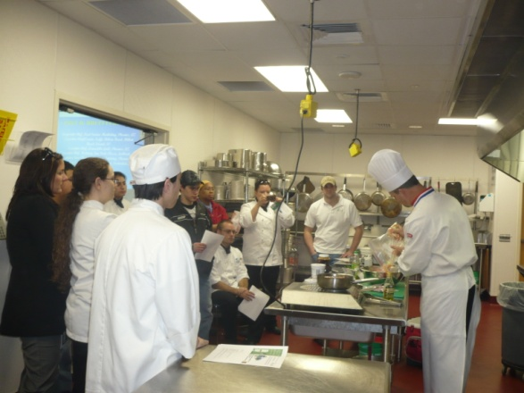
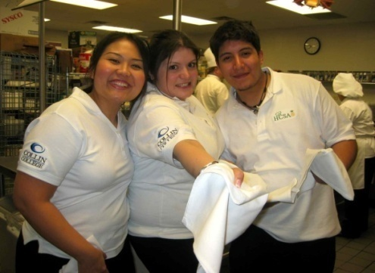
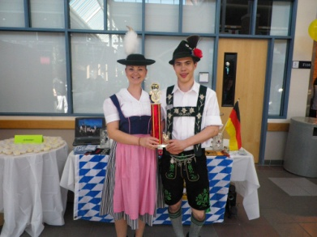
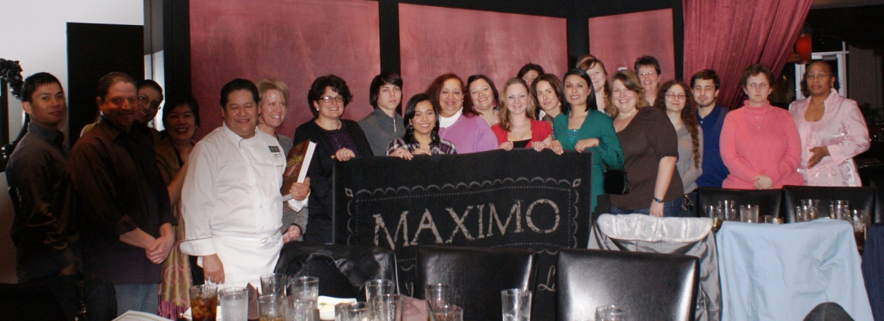
Hospitality and Culinary Student Association
Some HCSA Past Activities:
HOSPY Awards
Chef Tables
Bake Sales
Chili Confrontational
Treats for Christmas
Thanksgiving Pie Sale
Trips to NYC, Chicago &
Washington DC

Slide 38

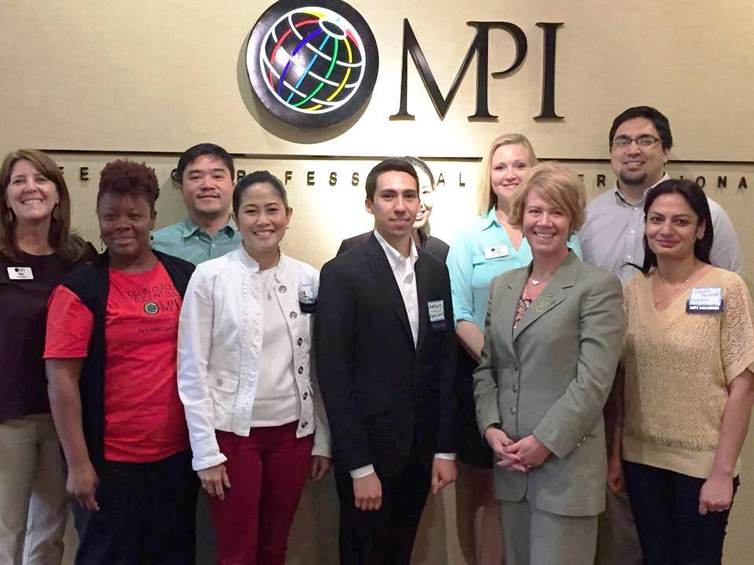
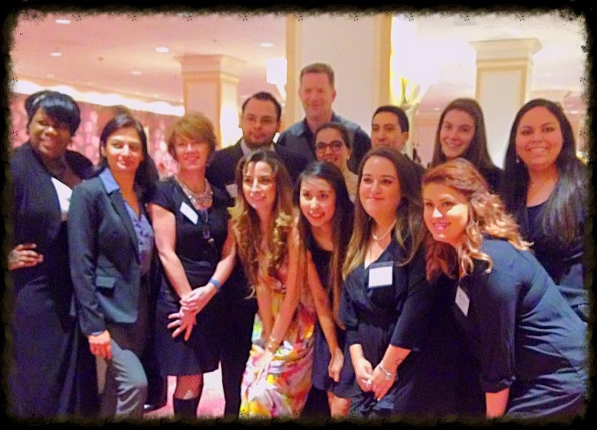
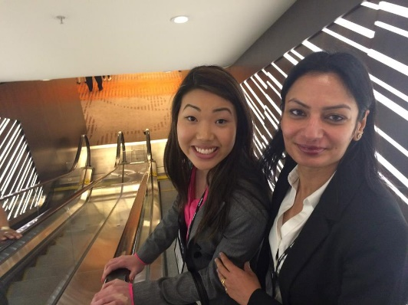
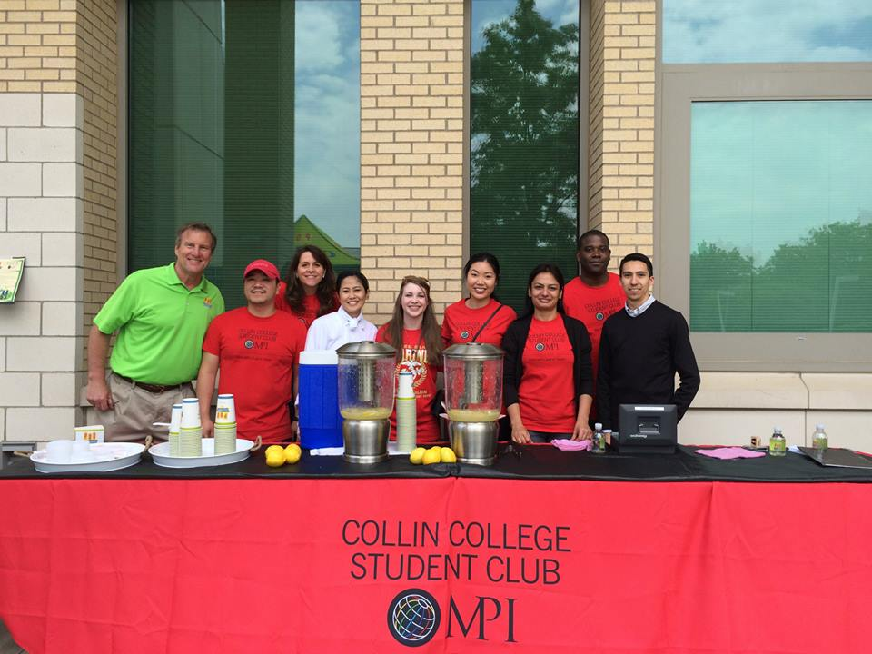
Meeting Professionals International
First MPI Student Club in Texas-Collin College Chapter
Some MPI past activities:
Networking Events & Meetings
TopGolf Allen
Samaritan Inn Gala
World Education Congress at
San Francisco & Atlantic City
Christmas Party at Dallas Arboretum
Fundraising with PDQ

Slide 39
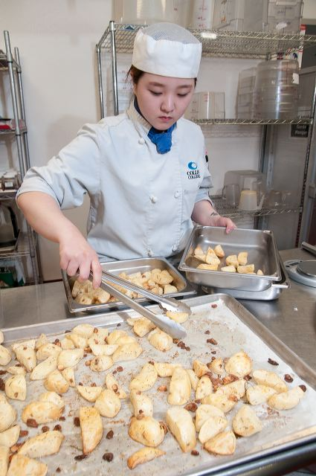
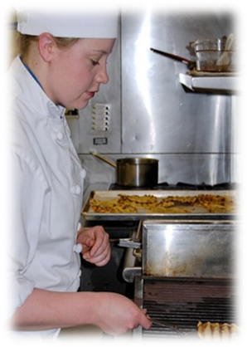
To learn more about the program, HCSA, MPI, and other outstanding faculty, visit: www.collin.edu/hospitality
IHCE Website

Slide 40
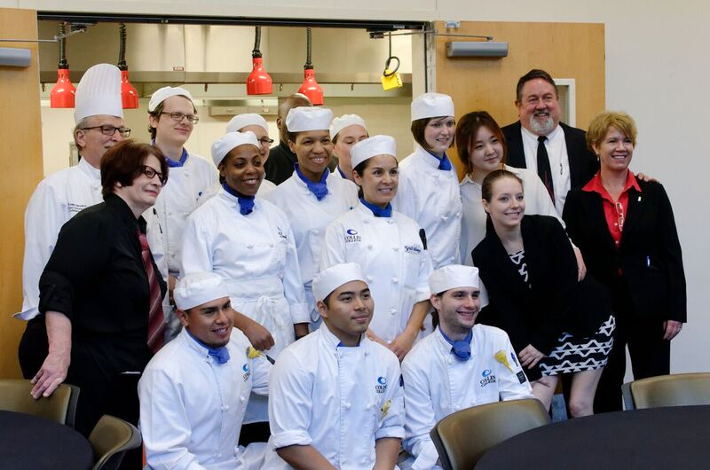
Thank you for coming to our
Culinary & Pastry Student Orientation!
Please Complete Form:
  9-digit CWID #
  Print all information clearly
ANY QUESTIONS??

