Slide 7
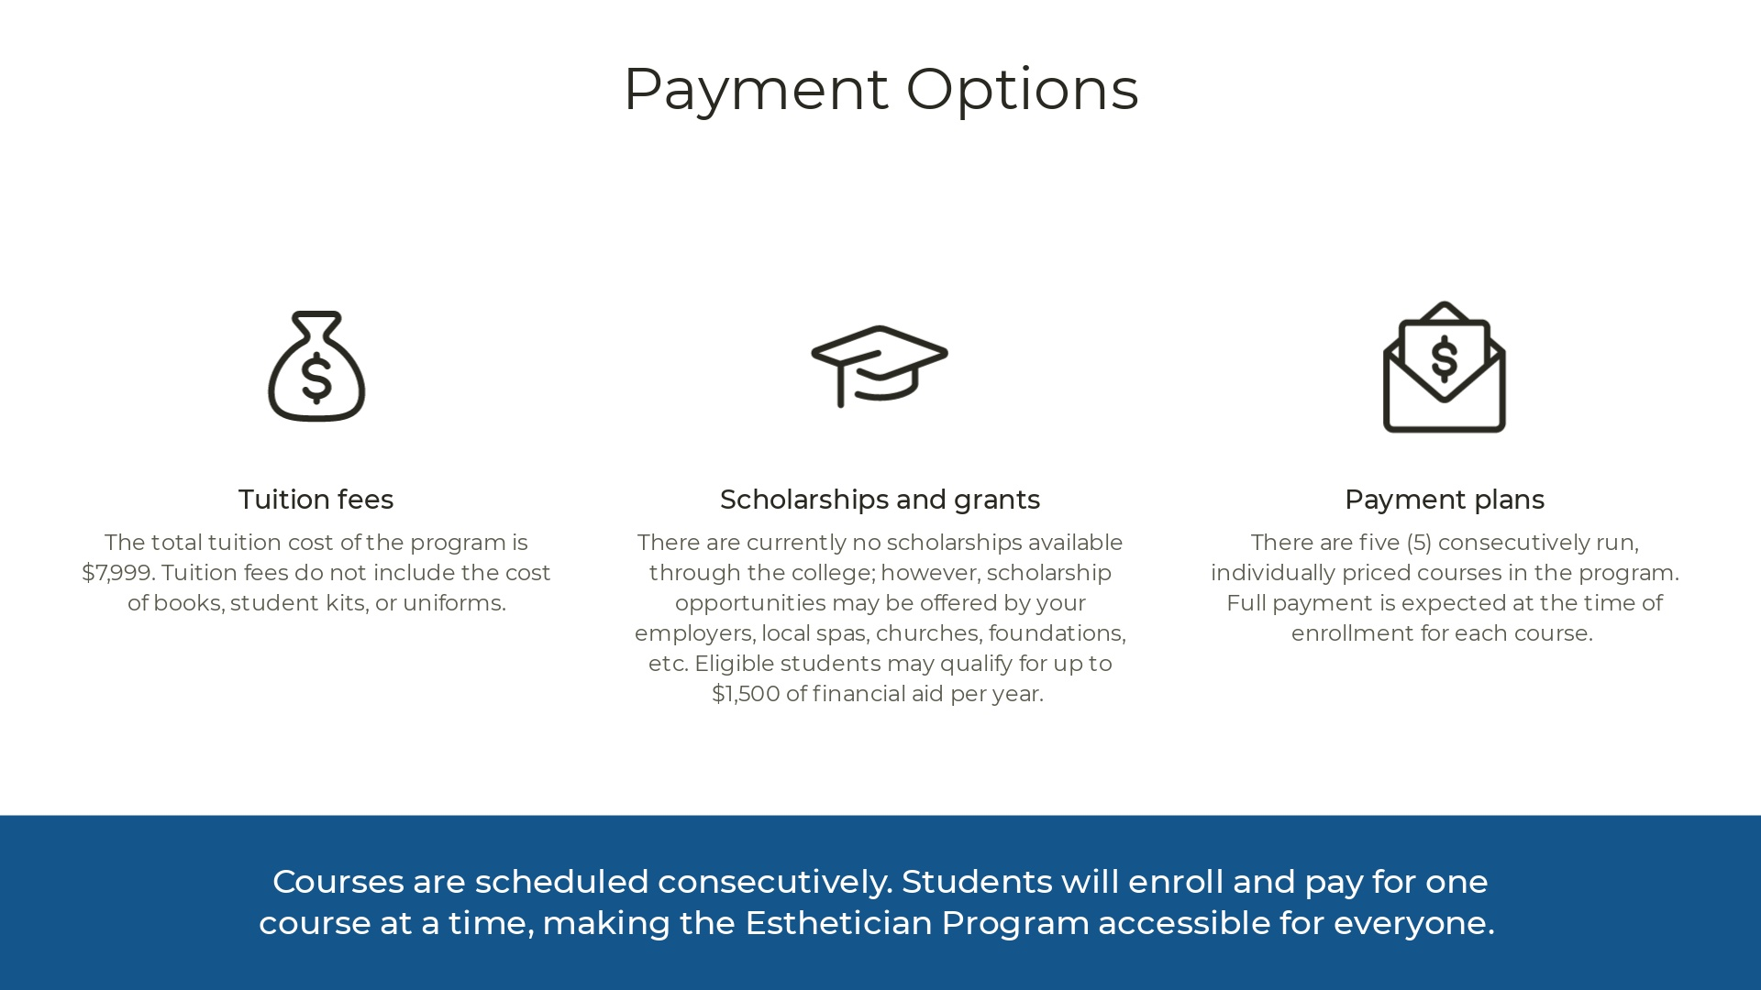
*Texas Department of Licensing and Regulation (TDLR)
Student Learner Permit Fee: $25
Total with Permit Fee: $8,024

Slide 9
***TDLR Permit Fee : $25

