Slide 1


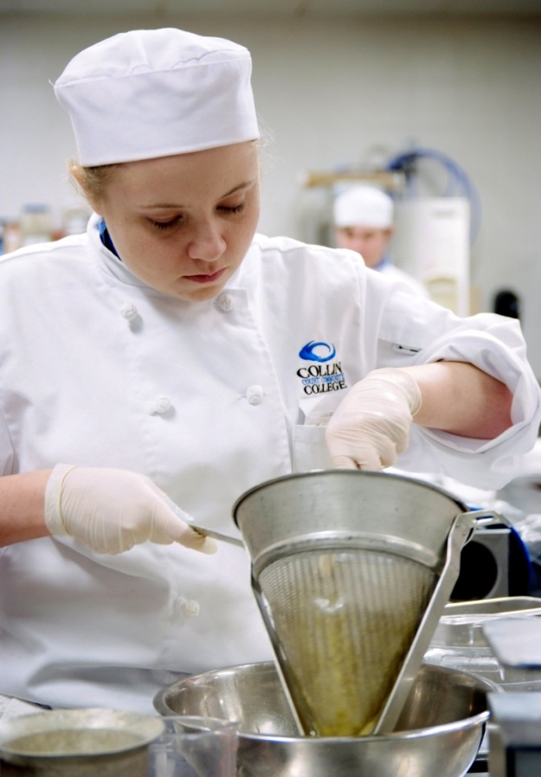
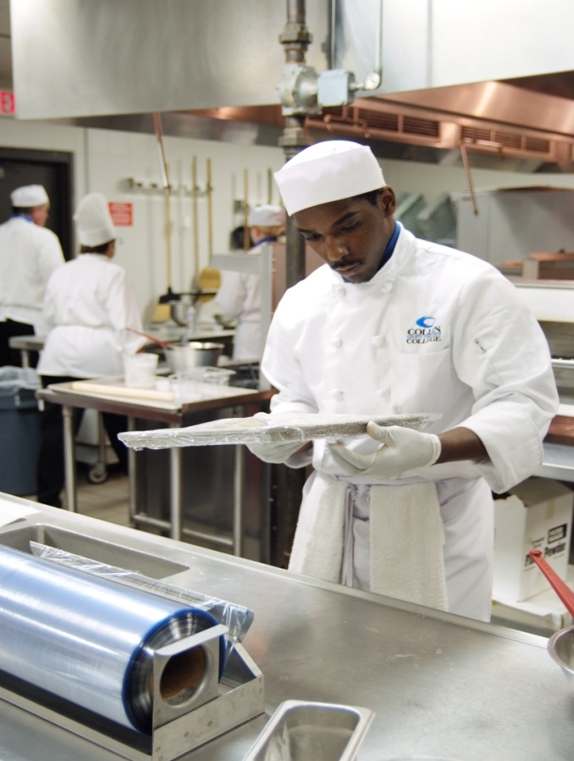
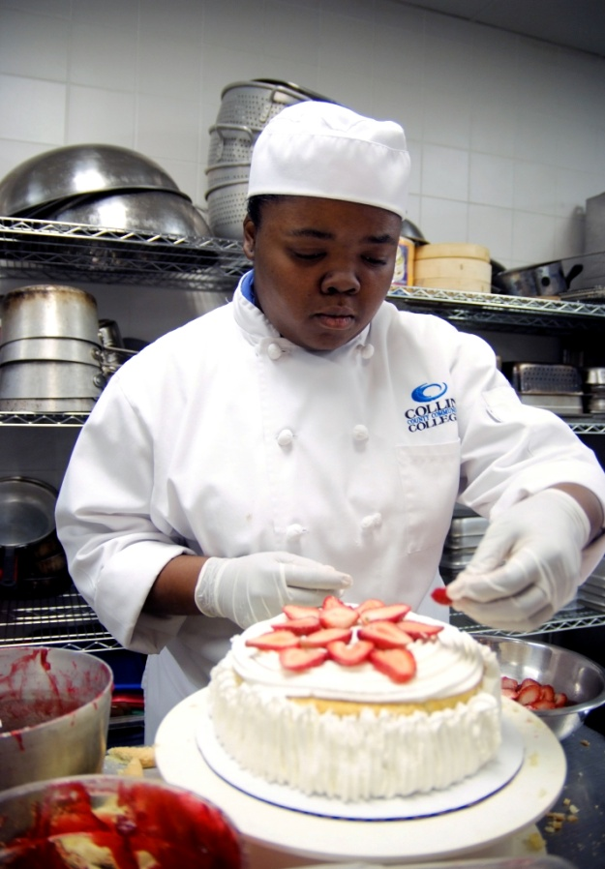
Welcome to
Collin’s Culinary & Pastry Arts
Student Orientation

Slide 2
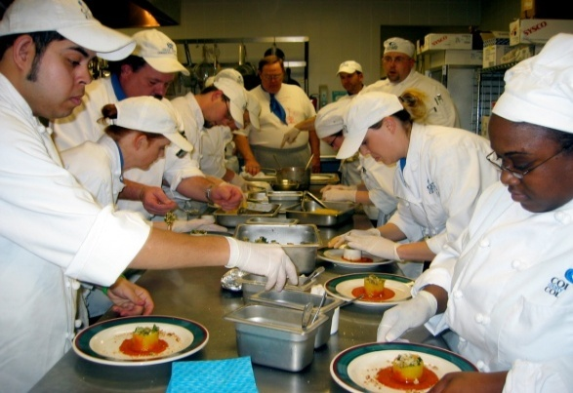

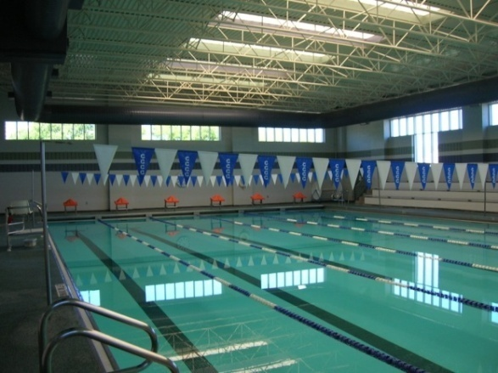
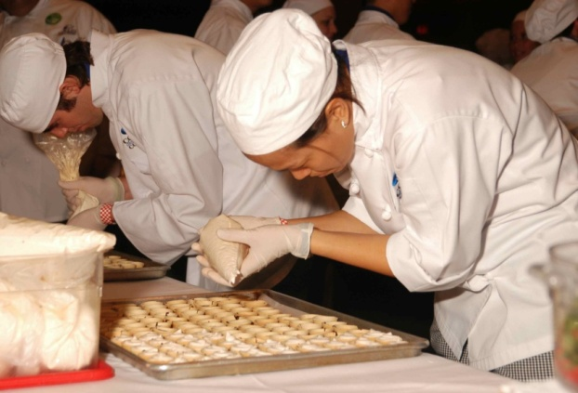
Program History
Lodging Management- 1997
Culinary Arts AAS- 1999
Pastry Arts AAS- 2009
Meetings & Event Management AAS - 2012

Slide 3
IHCE Mission Statement
The Institute of Hospitality & Culinary Education prepares students for the demands of the fast-paced hospitality and foodservice industry. We are committed to developing skills, strengthening character and work ethic, and challenging the student’s intellectual and creative curiosity.

Slide 4
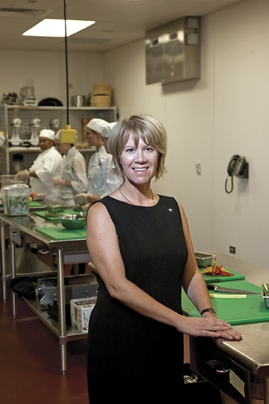
IHCE Faculty & Staff
Karen Musa
MBA, CHE, CTA
Program Chair & Professor
MBA – Dallas Baptist University
BS Hospitality Management
AS Hotel Restaurant Management - Johnson & Wales University
Office PRC -L229
972 377-1672
kmusa@collin.edu

Slide 5
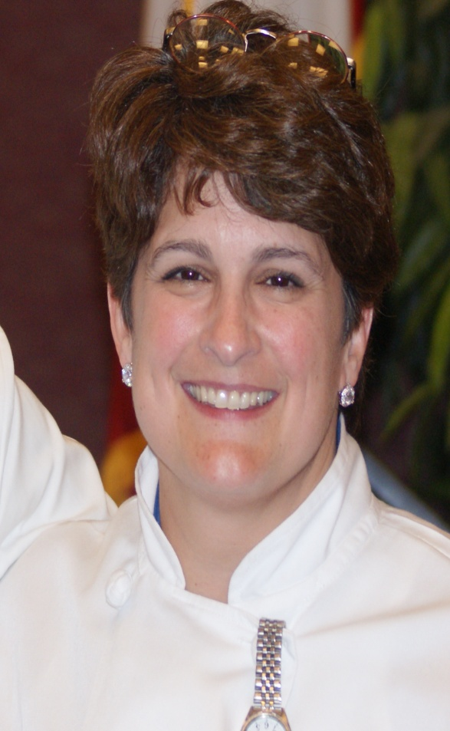
Chef Michele Brown
IHCE Faculty & Staff
Professor of Pastry Arts
BS Food Service Management - Johnson & Wales University
AOS Pastry Arts
- Johnson & Wales University
Medaled at the IKA Culinary Olympics 2012 Texas Regional Team
Office: PRC - A154
Phone: 972 377-1057
mebrown@collin.edu

Slide 6
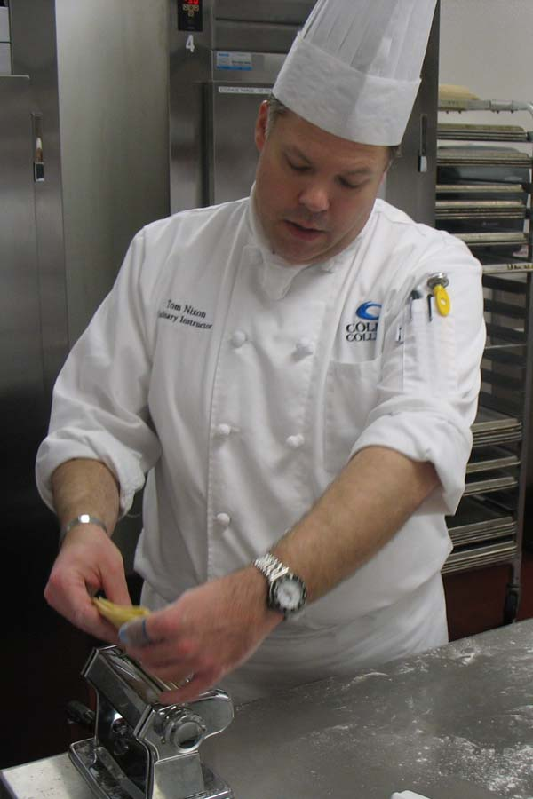
IHCE Faculty & Staff
Chef Thomas Nixon
Professor of Culinary Arts
A.A.S. Food and Hospitality Service
-El Centro College
Office: PRC - A155
Phone: 972-377-1752
tnixon@collin.edu

Slide 7
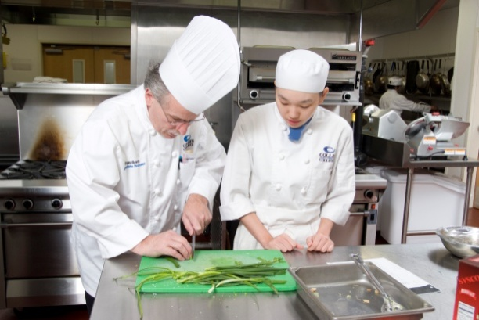
IHCE Faculty & Staff
Chef Tom Severs
Professor of Culinary Arts
A.O.S Culinary Arts
-Culinary Institute of America
Office: PRC - A156
Phone: 972-377-1773
tsevers@collin.edu

Slide 8
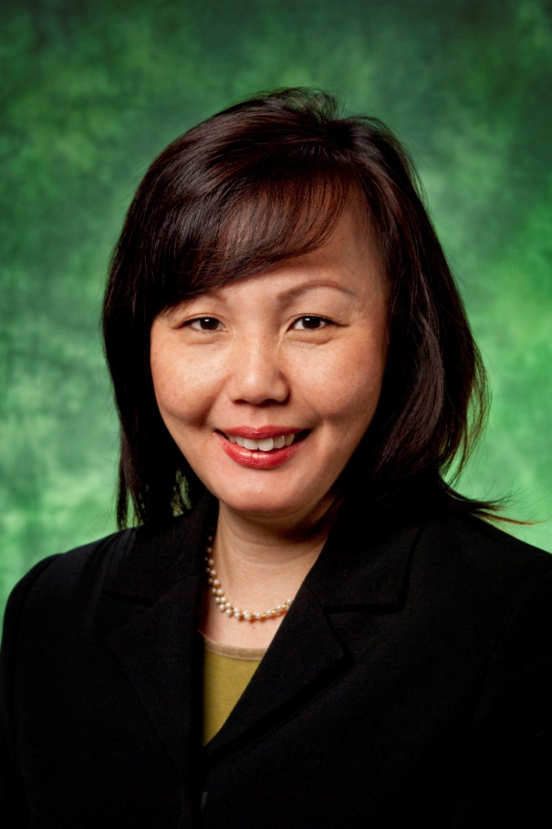
IHCE Faculty & Staff
Linda Wee
Professor of Hospitality and
Event Management
MBA - Sul Ross State University
Diploma – Hotel Management
  Singapore Hotel Association Training
  Education Center
Office: PRC – H 240
Phone: 972-377-1702
lwee@collin.edu

Slide 9
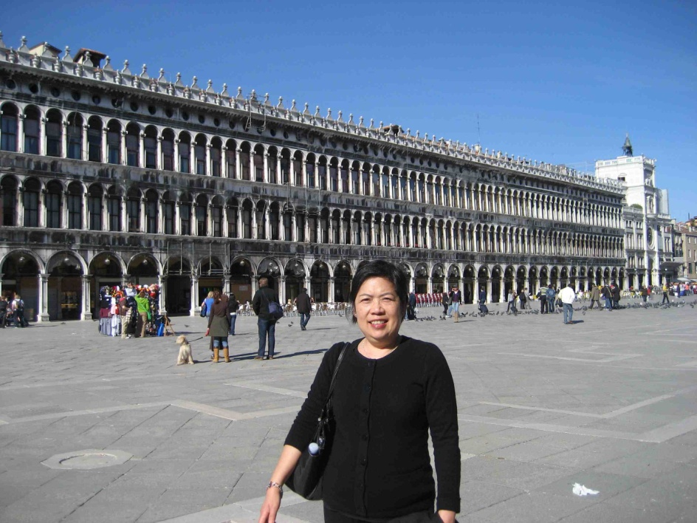
Sheila Kao
IHCE Faculty & Staff
Culinary Lab Coordinator
MS Finance
- University of Texas Dallas
Culinary Arts Certificate
- Collin College
Office PRC - A158
972 377-1068
skao@collin.edu

Slide 10
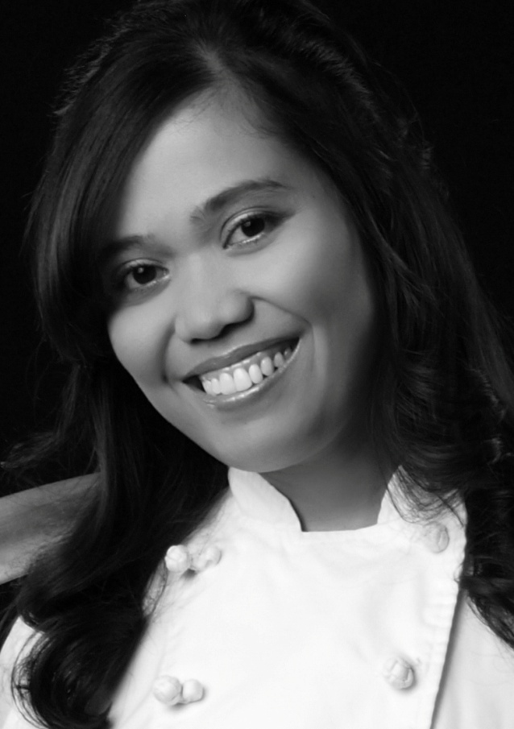
IHCE Faculty & Staff
Chef Karen Martin
Culinary Lab Assistant
A.A.S. Culinary Arts
- Collin College
B.S. Hotel, Restaurant and Related Institution Management, University of the Philippines
972 377-1084
kbmartin@collin.edu

Slide 11

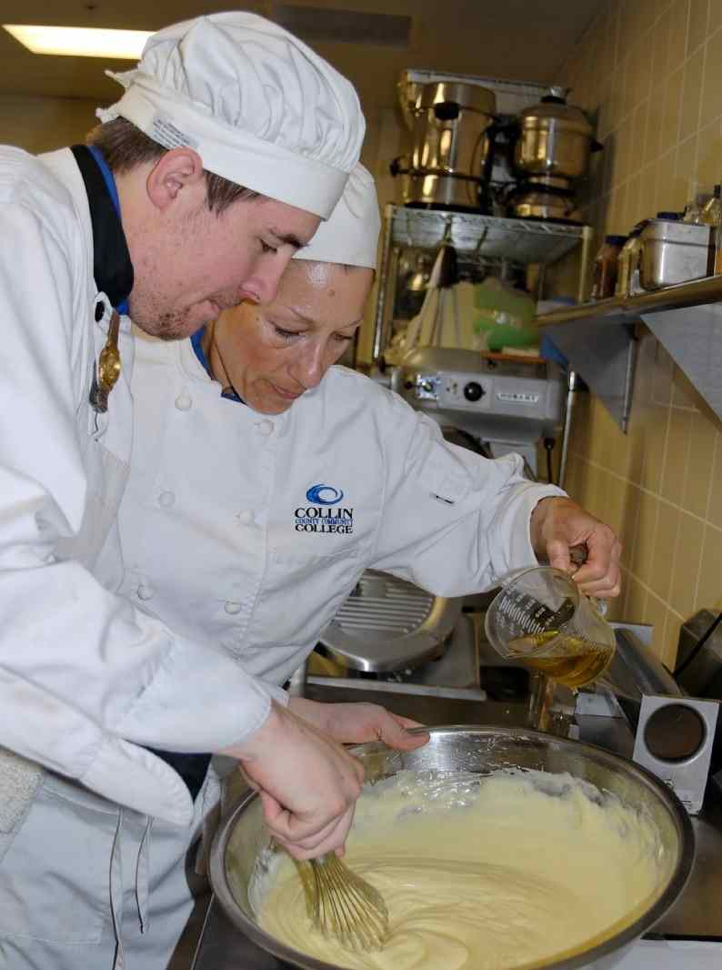
IHCE Program
Degree Programs:
Hotel & Restaurant Management or
Meetings & Event Management
AAS Degree
64 credit hours
Culinary Arts or Pastry Arts
  AAS Degree
70 credit hours
Articulation with:
  Texas Woman’s University
BAS - Culinary Science & Food Service Management
  Conrad N. Hilton – University of Houston
  University of North Texas

Slide 12

ACF Accredited Program
AAS Culinary Arts = CC
AAS Pastry Arts = CPC
  ACF membership
  Submit transcripts
Official in January 2013

Slide 13

Certificate Programs:
IHCE Program
Culinary Arts Certificate
24 credit hours
Pastry Arts Certificate
24 credit hours
Hotel/Restaurant Management Certificate
27 credit hours
Meetings and Event Management Certificate
24 credit hours

Slide 14
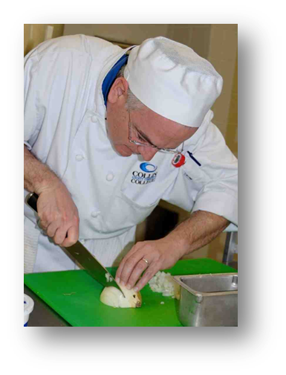
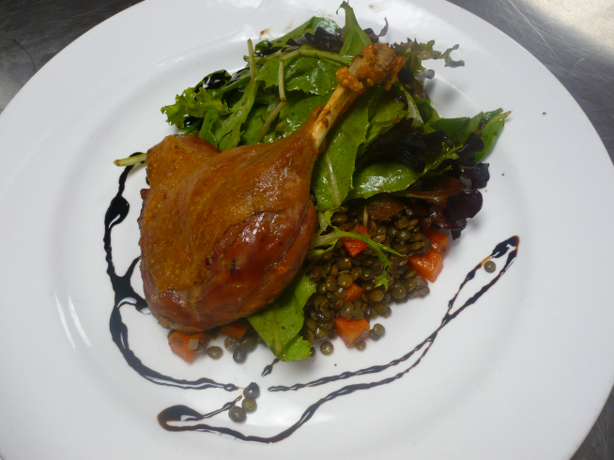
What does it take to be a chef?
Well rounded education in
techniques,
curiosity and dedication to craft!

Slide 15



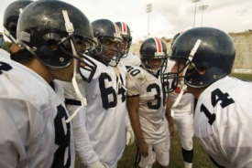

What does it require from you?
Commitment
Determination & Perseverance
Professionalism
Willingness to work in a team

Slide 16
Required Supplies for Class
For Culinary, Pastry, & Hotel/Restaurant Students
1. Uniform
2. Tool Kits and supplies
3. Books

Slide 17
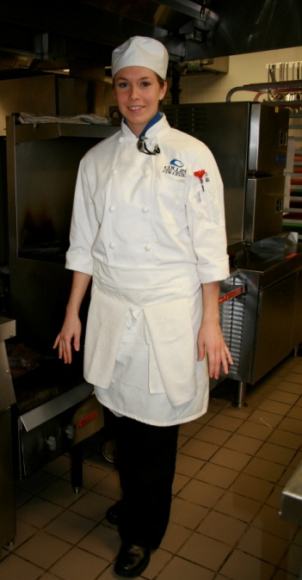
1. Full Uniform
"A Chef's professional pride can be extended to personal appearance and behavior in and around the kitchen"
Chef’s beanie hat - $7.30
Neckerchief - $2.90
  blue for culinary
  black for pastry
  white w/blue stripe for
  hotel/restaurant - $5.10
White double-breasted chef’s jacket
$27.75 - $29.75 (depends on size) ~with Collin logo
…all prices are subject to change without notice

Slide 18
1. Full Uniform continued…
Black chef pants $22.60 - $26.60 (depends on size)
White Utility apron $4.60
Side towels - $.90
Black leather non-slip shoes –must have a back; kitchen only
White tee shirt only
White/Black cotton socks – tube sock
“It takes years to become a chef. It only takes minutes to look like one!”

Slide 19
2. Tool Kits and Supplies for both culinary and pastry
Knife Kit
  8” Chef’s Knife
  3.5” Paring Knife
  9” Serrated Knife
  5” Boning Knife
  10” Steel Blade
  8 Pocket roll bag turning
Grand Total = $142.35
1 Fish Spatula- ($10.75) optional
Note: Not required for Hotel/Restaurant Students

Slide 20
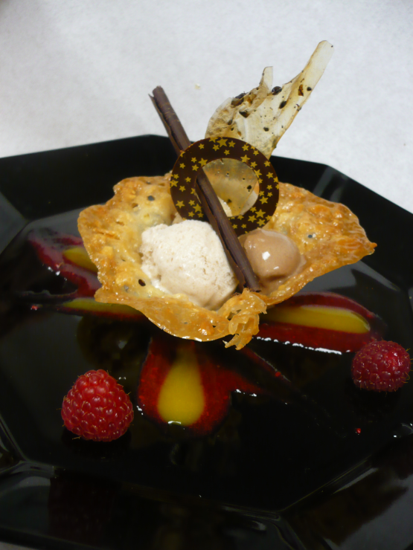
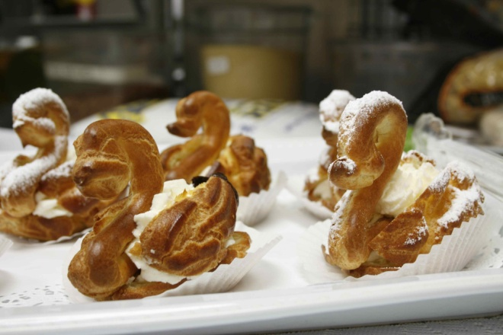
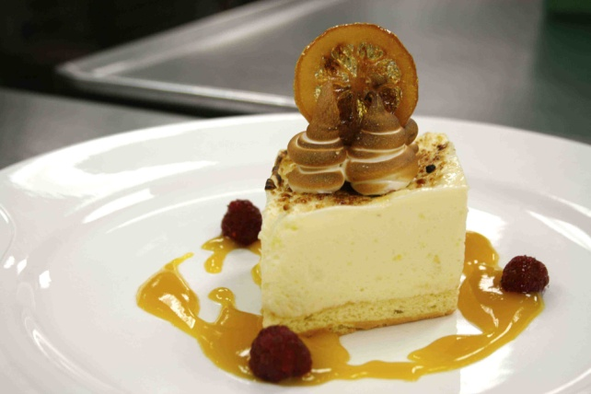
For both Culinary and Pastry
1 each Digital Thermometer- $17.50
6 each White Side Towels
1 set Measuring Spoons -$8.20
1 each Peeler-$3.70
Heat resistant Spatula- $16.60
Whisk- $7.60
Tongs- $7.10
Note: Not required for Hotel/Restaurant Students

Slide 21
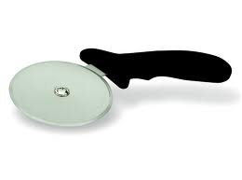
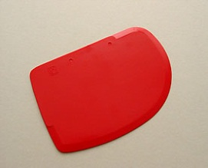
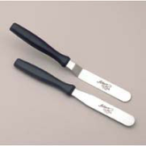
Additional Pastry Tools :
1. Pizza Cutter- $4.40
2. Digital Scale (oz/grams)- $57.75
3. Plastic Scraper- $1.25
Pallete Knife – 4 and 8 inches- $ 11.00
5. Micro plane- $17.00
Note: Not required for Hotel/Restaurant Students

Slide 22
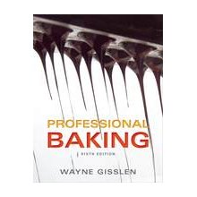
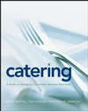
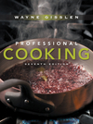
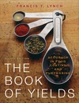
3. Text Books for Class
PASTRY PSTR 1301
CULINARY CHEF 1301
CATERING RSTO 2307
Fundamentals of Baking
Professional Baking
Wayne Gisslen:, 2012,
6th Ed.
Basic Food Preparation
Professional Cooking
Wayne Gisslen:, 2009, 7th
Ed.
The Book of Yields: Accuracy in Food Costing and Purchasing
Francis T. Lynch, 2010 8th Ed.
Catering Management
Catering: A Guide to Managing a Successful Business Operation
Bruce Mattel, 2008

Slide 23
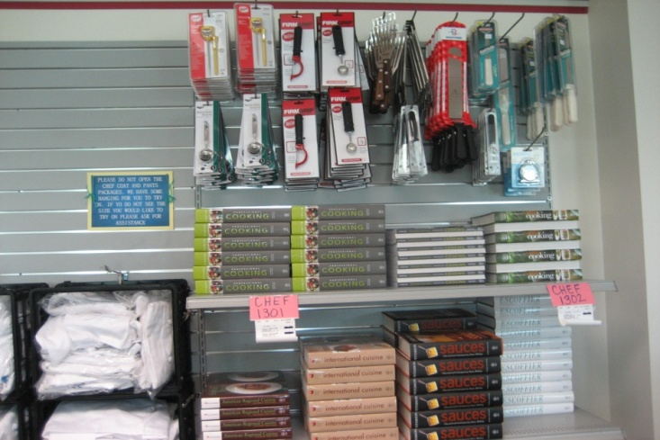
Required uniform items, knife, tool kits and books are available at
PRC bookstore
If they are out of stock, instructor will give you the names of reputable suppliers

Slide 24
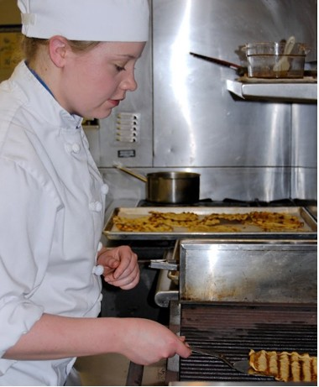
Outline of Typical Culinary/
Pastry Arts Class
Student arrives to lecture on time and having check their cougar email account
Students must be in full uniform in classroom and in the kitchen
Be prepared to start class with:
  Notebook
  Textbook
  4x6 index cards
  Pocket note book
  Pens/pencils
  Class handouts
  Calculator

Slide 25
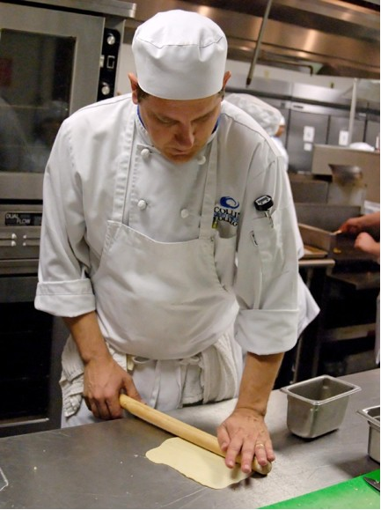
Outline of Typical Culinary/
Pastry Arts Class
Hands on cooking/baking lab in either:
A151 - Advanced Food Prep Kitchen
A152 - Skills/Stock Kitchen
A153 - Baking and Pastry Kitchen
  Food tasting & critique
Kitchen clean up

Slide 26
Kitchen Protocol
Full uniform must be worn in the Culinary Arts Kitchen and Bakery. Students will not be permitted to enter class without full uniform.
Uniform must be clean and wrinkle free. Students will not be permitted to enter class otherwise. It is advisable to bring along an extra apron to class.
Finger nails should be clean and short. Absolutely no nail polish or fake nails.
Jewelry should be limited to a metal wedding band. No earrings or other visible piercings.
Make-up should be worn sparingly. No false eyelashes.
All male students should be clean-shaven daily. Sideburns should be clipped one inch above the earlobes.

Slide 27
Kitchen Protocol cont.
Your hair should not touch your collar. Hair should be either kept very short or pulled under your chef’s hat using a hair net.
No chewing gum, drinking or eating (other than taste testing) is permitted in the Culinary Arts Kitchen or Bakery.
No running or horseplay.
No cell phone usage in the culinary labs this is a violation of the student code of conduct.
No food shall leave the Institute for Hospitality & Culinary Arts facility. All food prepared during class time must be consumed during class time.
No personal effects in the kitchen, purses, coats etc. Lockers are provided; students will need to bring their own locks for their lockers. Lockers must be vacated daily.

Slide 28
Kitchen Protocol cont.
Attendance is extremely important for all classes. Most classes will build off the previous class to develop skills and cooking methodologies. This is the time to start building a strong work ethic, which will aid in your success as a Professional Chef. Three absences will equal an automatic final grade of “F”.
Classes cannot be made up!
If you are late for class, it is at the discretion of the instructor whether or not you will be admitted to class and credited with attendance for that day.
Each student is graded daily on the five following categories:
  Use of tools, knives, equipment
  Mise-en-place
  Presentation of finished product
  Sanitation
  Class participation/responsibility
If you are not in class you will not receive a grade!

Slide 29
Grade Standards
CHEF 1305 Sanitation & Safety
  A final grade of “C” or higher to move past CHEF 1301 & PSTR 1301
CHEF 1301 Basic Food Preparation
  A final grade of “C” or higher to move into more advanced culinary classes
PSTR 1301 Fundamentals of Baking
  A final grade of “C” or higher to move into more advanced pastry classes

Slide 30
Degree Course Sequence
AAS Culinary
  CHEF 1301
  CHEF 1305
  HAMG 1321
  IFWA 1310
  CHEF 2331
  CHEF 1341
  CHEF 2302
  RSTO 1325
  CHEF 1302
  HAMG 1319
  CHEF 1310
  CHEF 1345
  HAMG 1324
  PSTR 1301
  CHEF 2380
  CHEF 1314/RSTO 1304 (CAPSTONE)
AAS Pastry
  CHEF 1301
  CHEF 1305
  HAMG 1321
  PSTR 1301
  HAMG 1324
  IFWA 1310
  PSTR 1305
  RSTO 1325
  HAMG 1319
  PSTR 1306
  PSTR 1310
  PSTR 1312
  PSTR 1340
  PSTR 2307
  PSTR 2301
  PSTR 2380
  PSTR 2331 (CAPSTONE)
Note: Does not include AAS General Education
Core classes. Classes may be scheduled as needed.

Slide 31
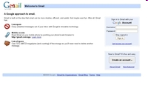
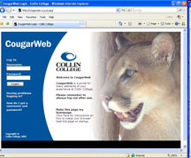
Communications
CougarWeb and Cougar Mail
Blast emails from program chair

Slide 32

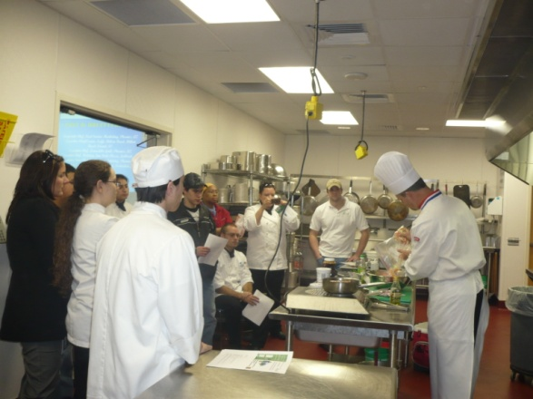
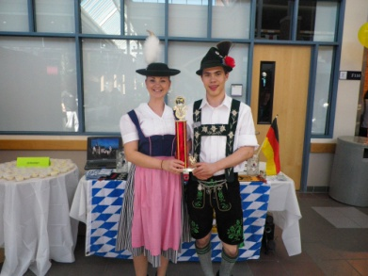
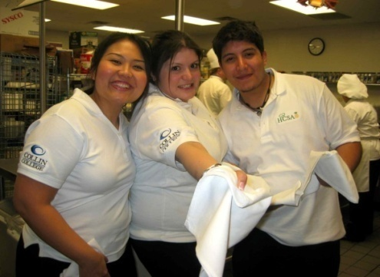
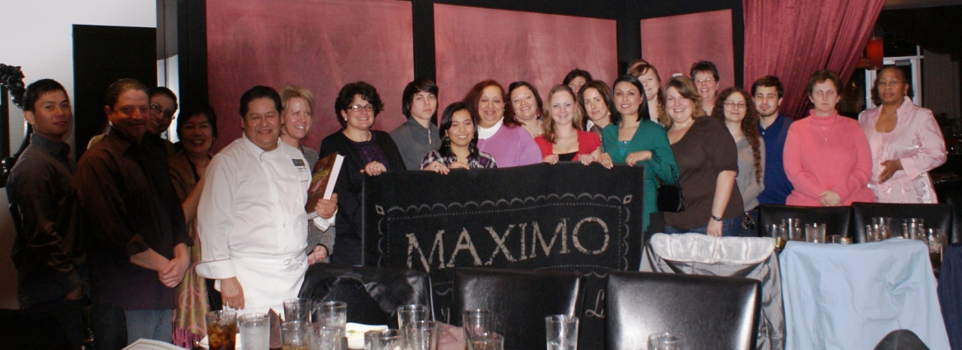
Hospitality and Culinary Student Association
Some past activities:
HOSPY Awards
Chef Tables
Bake Sales
Chili Confrontational
Treats for Christmas
Thanksgiving Pie Sale
Trips to NYC, Chicago &
Washington DC
Student run organization
Enrich your college experience!!!
Get involved - become
an officer or member
It’s absolutely free!
Follow us on Facebook

Slide 33
To learn more about the program, HCSA, and other outstanding faculty, visit: www.collin.edu/hospitality
IHCE Website

Slide 34
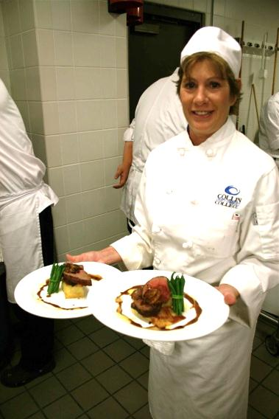
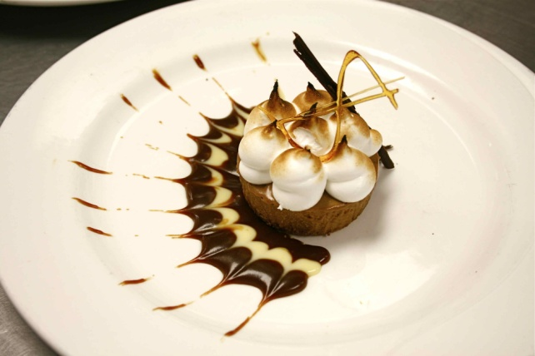
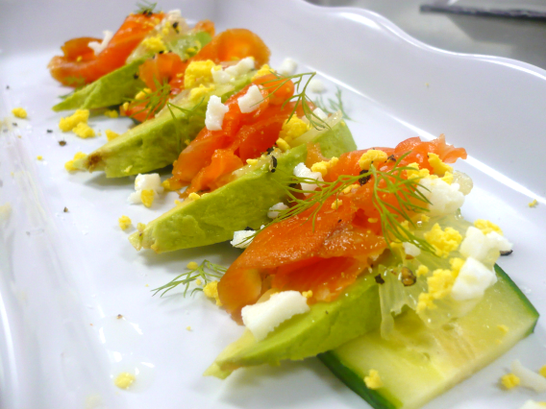
Thank you for coming to our
Culinary & Pastry Student Orientation!
Please Complete Form:
  9-digit CWID#
  Print all information clearly
ANY QUESTIONS??

