Slide 1
Notes:
1
Good______________. My name is Mike Richardson….and I am an Account Manager with Deer Oaks EAP services….and I’m here today to talk with you about your EAP benefits.
First, how many here know what and EAP is?

Slide 2
Your EAP Services
Telephone and crisis counseling 24-7, 365
Nationwide service
Face-to-face or telephone based short term counseling - 8 visit model (per issue, per person, per year)
Professional referrals to community resources as needed
National Relay Toll-free phone number for the hearing impaired
Notes:
You or your family member can utilize Deer Oaks EAP Services for up to 6 visits per issue per year.
How does that work….well lets say you visit with a counselor for stress and use your six sessions……. then later in the year…you have a death in the family and need grief counseling…you can utilize the service for another six visits for a different issues.
I often get the questions……….what if I need more than 6 visits for my counseling services?
If an employee/dependent needs a longer-term psychotherapeutic approach to treatment, our clinicians will work with your medical benefit plan to either make a referral to another provider who accepts your medical plan or we will provide these services under the umbrella of your medical plan on an out of network basis.

Slide 3
Issues Deer Oaks can Help With
Job related stress
Problems with co-workers or supervisors
Marital Problems
Dealing with divorce issues
Family issues
Child or adolescent problems
Anger Management
Domestic Violence
Depression & Anxiety
Bereavement
Healthy Lifestyles
Referrals for Medical, Legal, & Financial problems

Slide 4
Who is Eligible for Services?
Full time employees only
All dependents at home or away
Anyone in your household
Everyone is eligible, up to 6 months after you retire. (voluntary separation or involuntary)

Slide 5
Making an Appointment is a Snap
Call Deer Oaks – 1-866-327-2400
All calls are answered by a Work Life Specialist
If accessing the counseling service you will be assigned one of our clinicians who will find the provider for you. The clinician will assure that the provider has open availability.
Participant will receive appointment information within 2 days of calling Deer Oaks.
Deer Oaks will take care of sending the counselor the authorization for services and arrange billing, so you avoid out-of-pocket charges.

Slide 6
Work/Life Services
Childcare Services
Child daycare referrals
Parenting and Adoption resources
Babysitters
Sick Child Care
Summer Programs
Day Camps
Residential Camps
Preschool ad Nursery Schools
Before and After School Care
Back-up and Odd Hour Care
In Home Care
Religious Camps
Sport Camps
Special Needs Camps
Referrals elder daycare, respite care, assisted living, and nursing homes
Assistance accessing Medicare resources and extensive resources for issues related to aging
Notes:
6

Slide 7
Work/Life Services
Eldercare Services
Referrals Elder Care/Adult Day Care
Assisted living Facilities
Nursing Homes across the Nation
Independent Living Centers
Cancer Care Centers
Alzheimer’s Support
Community Services
Senior Centers
Retirement Communities
Elder Substance Abuse Programs
Adaptive Transportation Services
Volunteer Organizations
Cancer Care Centers
Geriatric Case Management Programs & Services
Mental Health Resources
Medicare & Medicaid Questions
Insurance
Notes:
7

Slide 8
Work/Life Services
We offer referrals to providers, specialist, and resources to meet specific work, life, or care giving needs.
Additional Categories | Examples of Referrals
Work & Career Growth | Career Development, Resume Writing Services, Certification Programs
Daily Living & Convenience | Pet-sitters/Kennels, Relocation Services, Transportation/Travel Services, House Cleaners
Health & Wellbeing | Physician Searches, Safety Programs, Support Groups, Fitness Centers/Programs, Nutrition Programs
Parenting | Child Nutrition, Discipline, Toilet Training, Blended Families, Playgroups, Raising Teenagers, Grandparents as Parents
Education | Tutors, Enrichment Programs, Special Needs Education, Home Schooling, Financial Aid, Scholarships

Slide 9
Legal Services
Free 30min. consultation with a telephonic or local, in-person attorney.
Meetings with in-person attorneys are scheduled; meetings with telephonic attorneys are often immediate.
Consultation consists of an analysis of the situation and advice on how to proceed.
Employee receives a 25% discount off the attorney’s hourly fee.

Slide 10
Legal Services continued…
Coverage is available in all 50 states
Telephonic attorneys cannot self-refer, so you are assured unbiased advice
Access to over 105 legal forms
What is covered?
Covered Issues: Family Law, Criminal, Bankruptcy, Adoption, Elder Care/Wills/ Trusts/Estate Planning, Consumer Issues
Excluded Issues: Employment as it relates to employees and family members, one’s own business, class action lawsuits, taxes

Slide 11
Interactive Will Preparation (NOLO)
Now members will be able to create a legal binding simple state specific will at no cost through a step by step on line “interview process”.
It should work well for most people with typical assets such as a house, a car, savings, and investments. But there are some situations in which you may need more than a simple will and should get expert advice or, at the least, investigate your options.

Slide 12
Financial Services
Access to free telephonic financial counseling and education on a variety of issues related to consumer debt and budgeting.
Counselors address issues via a toll-free information line, and follow up by mailing supporting educational materials
Additionally, advisors are available without an appointment Monday through Friday, or through pre-scheduled Saturday sessions
All counselors are knowledgeable in a wide range of financial topics
Examples: Budget Preparation, Debt Consolidation, College Planning, Vacation Planning, Retirement Planning

Slide 13
ID Recovery
ID Recovery is a telephonic consultation service to help you recover from, and minimize the impact of, a breach of your identity.
Provides victims a 30-minute consultation with an identity recovery professional
The professional will assess the situation, create an action plan, and provide consultation on implementing the plan
Reduces time spent repairing compromised credit history
Restores peace-of-mind, while helping undo the damage

Slide 14
Take the High Road!
Your ride is on us!
Just pay for your cab keep the receipt, then call 1-866-327-2400 for instructions on getting your money back.
(Up to $45 - One time per year per person)
Notes:
Particularly …as we head into the holiday season, this is an important program. We want to see each and every one of you make it through year safe and sound so we and your employer ask you to Take the High Road. In other words, if you are high…play it safe.
If you should find yourself in a situation where because of alcohol, or a traumatic experience you are unable to drive, simply call a cab to take you home. Save your receipt and turn it in to us noting the date, time and the reason and we will reimburse you without notifying your employer.

Slide 15
Employee/Supervisor Newsletter

Slide 16
On Line Gold Mine
www.deeroakseap.com
Notes:
16
Points to Remember about EAP:
EAP is a paid benefit for you and your dependents by the city of San Angelo. The counseling is FREE, you don’t have to involve your insurance and pay co-pays or deductibles
Counseling is completely confidential.
Is Easy to access for help and Deer Oaks is a Resource you can TRUST

Slide 17
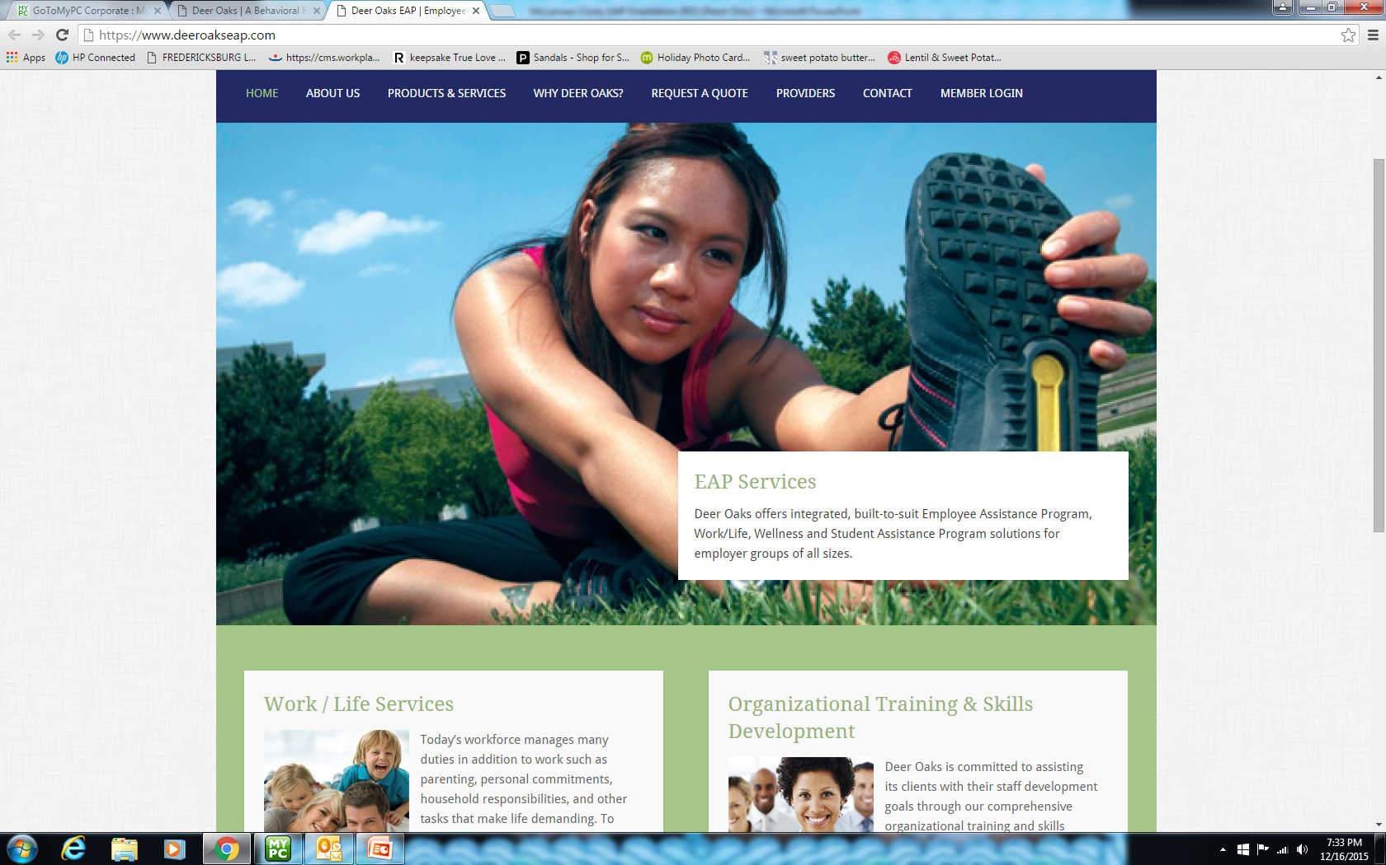
Login: collin
PW: collin

Slide 18
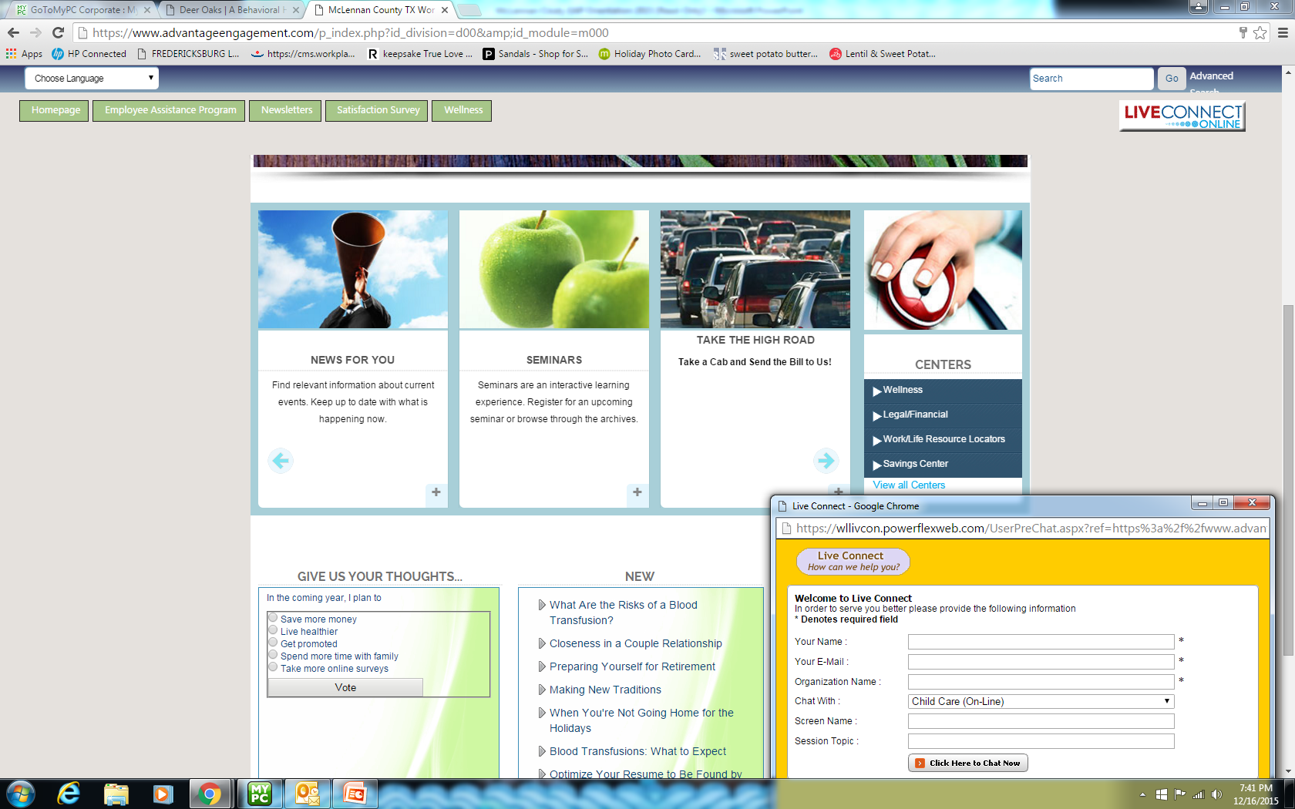

Slide 19
Accessing Services
Call Deer Oaks EAP Services:
1-866-327-2400
E-mail: eap@deeroaks.com
or go to: www.deeroakseap.com
Username & Password
collin
Notes:
Points to Remember about EAP:
EAP is a paid benefit for you and your dependents by the city of San Angelo. The counseling is FREE, you don’t have to involve your insurance and pay co-pays or deductibles
Counseling is completely confidential.
Is Easy to access for help and Deer Oaks is a Resource you can TRUST

