Slide 1
MODULE 1
Student Employment & Work Study Overview

Slide 2
Introduction
The following information is provided to assist supervisors of student employees with the policies, procedures and guidelines they must be aware of when employing student assistants or federal work study employees.
Following completion of these modules, you will be asked to complete a brief post-training quiz to track your completion of the training and ensure you have a thorough understanding of the material presented.
Modules
Student Assistant/Work Study Overview
Recruitment, Selection & Eligibility Guidelines
Policies, Procedures & Supervisor Responsibilities

Slide 3
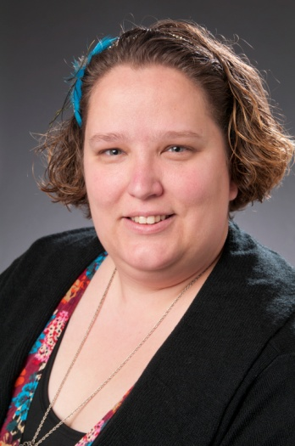
Student Employment
Sarah Henderson, Student Employment Coordinator, assists hiring managers and students with student employment and work study processes, procedures, systems and records relating to on-campus student employment.
Sarah Henderson
Human Resources Coordinator
CHEC – HR Department
shenderson@collin.edu
Phone: 972-881-5110
Fax: 972-985-3778

Slide 4
On-Campus Student Employment
On-campus student employment is designed to provide both financial assistance and work experience to Collin College students.
Students employed on campus are classified as either:
Work Study (WS) or
Student Assistants (non-WS).

Slide 5
ALL Student Employees
Student employees are employed to assist in various administrative and instructional departments.
The general job duties are outlined in the job description in CougarHR. Duties may vary slightly according to the specific needs of the department.
Student Assistants and Work Study Students may work a maximum of 20 hours per week, no exceptions.

Slide 6
Student Assistants (non-FWS)
Student Assistants are always paid from departmental budgets.
Student Assistants may work a maximum of 20 hours per week.

Slide 7
Work Study (WS)
Work Study (WS) students are paid through a financial aid award. Students must apply, qualify for, and accept a WS financial aid award in order to be eligible for WS employment.
Candidates selected for employment must receive final WS award authorization from the financial aid department
WS students are awarded a specific amount of money. They are eligible to earn their award through WS employment.
Students who have been awarded WS through the Financial Aid Office may apply online for on-campus WS positions, America Reads/Counts, or Community Service positions.

Slide 8
WS (cont.)
The amount earned by a WS student during any given term may not exceed the total amount of WS funds authorized by financial aid for that term. WS employment must cease when the amount awarded has been earned.
It is extremely important for WS students and supervisors to closely monitor the student’s work hours and remaining award amounts.
Individual departments must pay any additional amounts if the student exceeds the amount authorized for the term.

