Slide 1
Welcome to Collin
CE Instructor Orientation

Slide 2
Mission of Collin College
Collin County Community College District is a student and community-centered institution committed to developing skills, strengthening character, and challenging the intellect.

Slide 3

Core Values
We have a passion for...
  Learning
  Service and Involvement
  Creativity and Innovation
  Academic Excellence
  Dignity and Respect
  Integrity

Slide 4

Accreditation
Collin College is accredited by the Southern Association of Colleges and Schools (SACS) Commission on Colleges to award associate degrees and certificates.
The Southern Association of Colleges and Schools Commission on Colleges is the regional body for the accreditation of degree-granting higher education institutions in the Southern states.
Certain programs offered by Collin College are also accredited by specialized, industry-specific accrediting bodies.

Slide 5


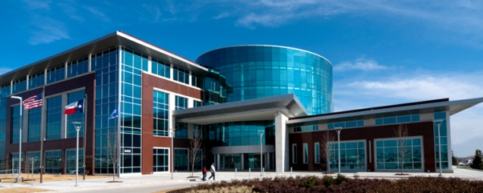

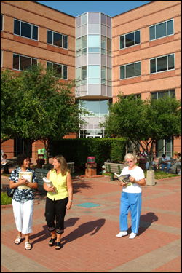


Our Campuses
Central Park Campus
2200 W. University Drive
McKinney, TX 75070
Collin Higher Education Center
3452 Spur 399
McKinney, TX 75069
Preston Ridge Campus
9700 Wade Boulevard
Frisco, TX 75035
Spring Creek Campus
2800 E. Spring Creek Pkwy
Plano, TX 75074
Courtyard Center
4800 Preston Park Blvd
Plano, TX 7507
Allen Center
300 Rivercrest Blvd
Allen, TX 75002
Rockwall Center
1050 Williams Street
Rockwall, TX 75087

Slide 6
What Makes Collin College
A Great Place To Work?
Stable Growing Organization. Since offering its first classes at area high schools in 1985, Collin College has expanded to serve about 53,000 credit and continuing education students each year. The only public college in the county, the college offers more than 100 degrees and certificates in a wide range of disciplines.
The Leadership. Collin College has great leadership, provided by experienced and knowledgeable Leadership Team members with oversight and vision provided by a 9 member Board of Trustees, which are at-large elected positions within the county.
The Employees. Collin College is a diverse organization with approximately 2500 dedicated employees. View the Personnel Headcount on the HR website for a current listing of employees by position type and campus.
The Culture. The Collin College Mission and Core Values of Learning, Service and Involvement, Creativity and Innovation, Academic Excellence, Dignity and Respect, and Integrity, were established for both students and employees. Employees exhibit Cougar Pride at all times by assisting in carrying out the mission of the college and honor the Core Values in interactions with students as well as fellow employees.
Great Benefits. Eligible full-time employees of Collin College enjoy free employee medical and dental coverage, free basic life coverage, 16 paid holidays (full-time staff), professional growth and development and much more.
Opportunity for Advancement. Collin College encourages employees to broaden their knowledge base and seek new opportunities within the college by offering professional development and tuition reimbursement programs.

Slide 7


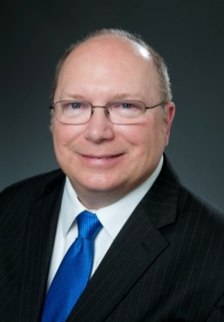



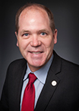
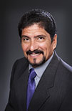

Meet The Board of Trustees
Collin College is led by a nine-member, elected Board of Trustees along with the district president.
Dr. J. Robert Collins
Chair
Founding Board Member
Stacy Anne Arias
Vice Chair
Andrew Hardin
Secretary
Nancy Wurzman
Treasurer
Mac Hendricks
Jenny McCall
Jim Orr
Adrian Rodriguez
Larry Wainwright

Slide 8
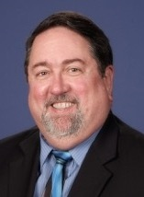
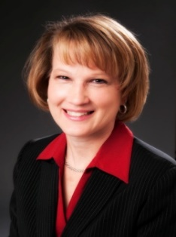
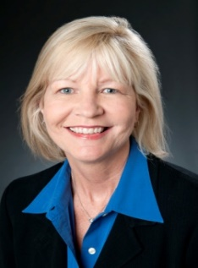
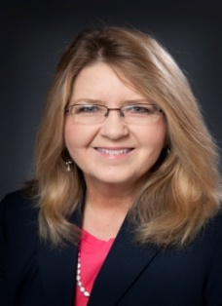
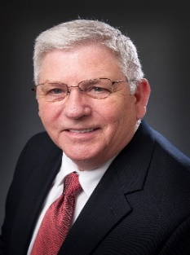

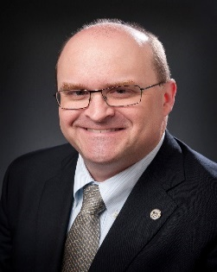
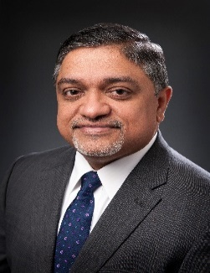
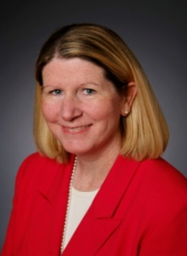

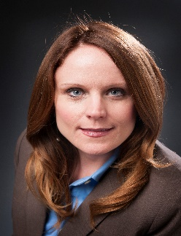
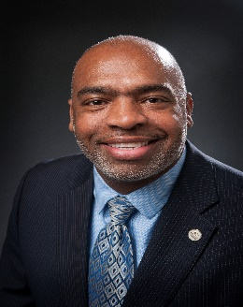

Meet the Leadership Team
Dr. H. Neil Matkin
District President
Dr. Brenda Kihl
Executive Vice President
Dr. Sherry Schumann
Senior Vice President
Academic, Workforce,
and Enrollment Services
Kim Davison
Senior Vice President,
Organizational
Effectiveness
Kenneth Lynn
Acting Vice President,
Administrative Services
and CFO
Lisa Vasquez
Vice President,
Advancement
Dr. Jon Hardesty
Vice President/Provost
Central Park Campus
Dr. Mary McRae
Vice President/Provost Spring Creek Campus
Dr. Dani Day
Vice President,
Academic and Workforce Development
Thomas Delameter
Chief Public Relations Officer
Jennifer Blalock
Vice President,
Workforce &
Economic Dev.
Albert Tezeno
Vice President,
Student &
Enrollment Svcs.
Dr. Abe Johnson
Vice President/Provost
Preston Ridge Campus
VACANT
Vice President,
Human Resources
VACANT
Vice President,
Policy and Planning

Slide 9
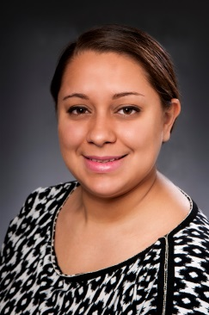
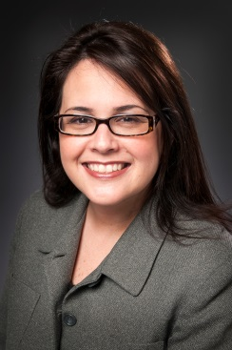

Meet Your HR Representatives
Rebecca Acuna
HR Consultant
  Spring Creek Campus
  Collin Higher Education Center
  racuna@collin.edu
  972-985-6664
Andreina Fowler
HR Consultant
  Central Park Campus
  Rockwall Center
  afowler@collin.edu
  972-599-3161
Jaslyn Lue
HR Consultant
  Preston Ridge Campus
  Allen Center
  jlue@Collin.edu
  972-758-3857
Christina Canales
Manager, HR/Benefits
All Campuses
ccanales@collin.edu
972-599-3164
Services Provided by the
Campus HR Consultants Include:
Services Provided by the Benefits Manager Include:
Recruiting
Job Postings
Job Descriptions
New Hire Process
Review Qualifications
Calculate Salaries
HR-Related Training
Employee Relations
Performance Management
Answer HR Questions
Communicate Info
Benefits & Insurance
Retirement (ORP/TDA)
Disability Claims
Insurance Verifications
Workers’ Compensation
FMLA/Leaves of Absence

Slide 10
Policies & Procedures
Collin College Board Policies. The Online Collin College Board Policies Manual can be found at www.collin.edu/hr/ and clicking on “Board Policies Manual”.
It is your responsibility, as employees of the College, to become familiar with the policies that govern our conduct. Please review the Policies & Procedures section provided in your employment packet.

Slide 11

EEO Training
Collin College is an equal opportunity employer and does not discriminate on the basis of race, color, religion, sex, national origin, age, disability or veteran status or other protected class.
Equal Employment Opportunity Information. The Collin College Equal Employment Opportunity Information as well as Board policy DAA (Legal) – Equal employment opportunity has been provided in the Policies & Procedures section in your employment packet.
ALL employees are required to complete two on-line training courses: “Unlawful Harassment Prevention” and “EEO Laws and Discrimination Prevention”. In addition, employees who may have access to student records will also be required to complete “FERPA for Higher Education” training.
Within the first several weeks of employment, you will receive an email from Workplace Answers with a training link to the courses listed above. Please complete these online training courses by the deadline stated in the email.

Slide 12
Pension/Retirement
Job Not Covered by Social Security
Your earnings at Collin College ARE NOT covered by Social Security. When you retire, or if you become disabled, you may receive a pension based on earnings from this job. If you do, and you are also entitled to a benefit from Social Security based on either your own work or the work of you husband or wife, or former husband or wife, your pension may affect the amount of the Social Security benefit you receive. Your Medicare benefits, however, will not be affected. Under the Social Security law, there are two ways your Social Security benefit amount may be affected.
Form SSA-1945 and Statement Concerning Your Employment in a Job Not Covered by Social Security. (Form is included in the Required Forms packet.)
If you have any questions or concerns regarding this form, you may visit ww.socialsecurity.gov.

Slide 13
Metlife PERC plan
All part-time Collin College employees are required to participate in the Program for Extra Retirement Compensation (PERC) in lieu of Social Security (FICA).
  Mandatory program through a 403(b) tax-sheltered annuity account with MetLife in lieu of Social Security contributions
  Employee contributes 7.5% of salary pre-tax

Slide 14

Texas$aver
Texa$aver is a voluntary retirement savings program offered through ERS.
The recordkeeper for Texa$aver is Empower Retirement.

Slide 15


Fitness Facilities, Wellness
Fitness Facilities
There is no charge for employees to use the college’s fitness centers. Collin College ID is required.
Oak Point Center (near SCC) belongs to the City of Plano, not the college. However, Faculty and Staff can utilize the pool with an ID. Please contact the Oak Point Center at 972-941-7540 or the Physical Education Office, x5925, for hours.
Wellness Programs
Collin College’s Wellness Program is dedicated to helping employees enjoy a healthier way of life. A variety of college-sponsored wellness activities, events and information are offered to Collin College employees including blood pressure checks, fitness assessments, exercise programs and wellness seminars.
Collin College also offers a Wellness Leave Program to provide incentive and time to participate in wellness programs. Full-time faculty and staff may participate in any of the college’s sports or exercise programs and receive matched time for their exercise efforts, within the Wellness Program Guidelines.

Slide 16


EAP, Employee Discounts
EAP
Collin College also offers a free Employee Assistance Program (EAP) which provides confidential services to help manage daily responsibilities, life events, work stresses or issues affecting quality of life. The EAP is available 24 hours a day, 7 days a week.
Employee Discount Programs
In addition to group benefit plans and college-sponsored programs, Collin College employees also receive a number of discounts or special services on a variety of items from area businesses including:
  Credit Unions
  Banks
  Auto/Home Insurance
  Automotive
  Consumer Products
  Dining
  Education
  Electronic Equipment
  Financial Services
  Health and Wellness
  Home and Garden
  Insurance
  Local Discounts
  Travel and Entertainment
More information about these benefits can be found on the HR Website.

Slide 17

Payroll
All employees are required to have Direct Deposit. Employees may view and print their pay stubs by logging into CougarWeb.
Part-time CE Instructors are paid based on type of class and course contact hours taught. Please refer to the current Payroll Chart in your employment packet for direct deposit dates.

Slide 18
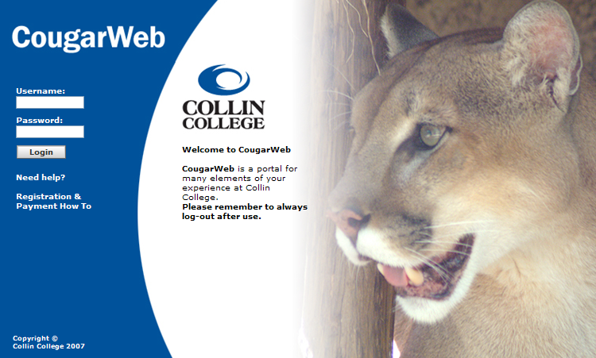
CougarWeb
CougarWeb is the portal into important information at Collin College. CougarWeb is used by students, faculty and staff.
The CougarWeb ‘My Workplace’ tab has employee information such as your check stub information, W2 forms, your leave balances, benefits information, college policies & procedures, calendars, forms and departmental intranet pages.
CougarWeb also provides employees of Collin College with access the college’s library databases and resources and remote access to their college email account.

Slide 19

Collin Mobile App
Yes! There’s an app for that!
Collin College App is available for Apple products and Google Play
Through the app, you can access:
  Calendar of events
  Map of each campus
  Class schedule
  CougarWeb and so much more!

Slide 20
Campus Security & Emergencies
The safety of our students, employees and visitors is extremely important to us. We have a number of well-trained, dedicated men and women who serve as Collin College Police Officers and Dispatchers. These individuals are all committed to making our classrooms, workplace and the community a safe place to study, work and enjoy.
The campus police are available 24/7/365.
Visit Collin College’s Police Department Website to learn more about our Police Department services, campus emergency information, campus policies and contact information.
Emergency Contact Numbers:
Call 911 if necessary.
To reach Collin College’s Police Dispatch Line:
  On-campus: Dial extension 5555
  Off-campus: Dial 972-578-5555

Slide 21

CougarAlert
When an emergency occurs, the college’s CougarAlert system can send email, text messages and voice messages to employees and students in as little as 90 seconds.
CougarAlerts will be sent in emergencies that require unscheduled closure or evacuation of a campus or the district. This includes, but is not limited to weather closures, power outages, police emergencies, catastrophes and/or hazardous exposures. CougarAlerts will not be used for promotional purposes or for scheduled closures, such as holidays.
All employees are strongly encouraged to subscribe to CougarAlert.
To subscribe, visit: http://www.collin.edu/cougaralert.html

Slide 22

Help Desk & Media Services
Help Desk
The Help Desk is available to assist employees with technology issues. The Help Desk can be reached most conveniently by dialing x6555 from any phone on campus, or by emailing HelpDesk@collin.edu.
You can also find Academic Technology and Network Services tutorials online to assist with Blackboard, CougarWeb, CougarMail, Pharos, Accessing network drives remotely/Virtual Office, Phones and Voicemail, general technology and software tutorials and much more!
You can also check out software from the Help Desk to install on your home computer if it is for work-related applications.
Media Services
Media Services staff are available at each campus to assist with classroom technology issues, requests for video equipment, laptops, projectors and much more.

Slide 23


Helpful Information
Who’s Who at Collin College
Collin College’s Organization Chart is available on the HR website.
Get Involved and “Be in the Know”
Check out the Collin College Event Calendar for upcoming college events.
Watch for college-wide announcements about college news and events or opportunities to participate in Collin College committees, task forces or activities.

Slide 24

Helpful Information (cont.)
Collin College Athletics
The college nickname used by our athletic teams and other organizations throughout the college is the Collin College Cougars.
For athletic event schedules, visit: http://www.collin.edu/athletics/.

Slide 25
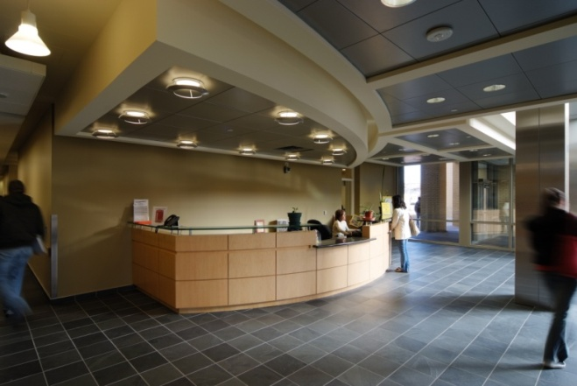
Helpful Information (cont.)
Information Desks & Room Reservations
The Information Desk at each campus can help with general inquiries, provide directions, and receive visitors and callers.
If you have a meeting scheduled, notify the Information Desk so your attendees can be directed to the appropriate location.

Slide 26
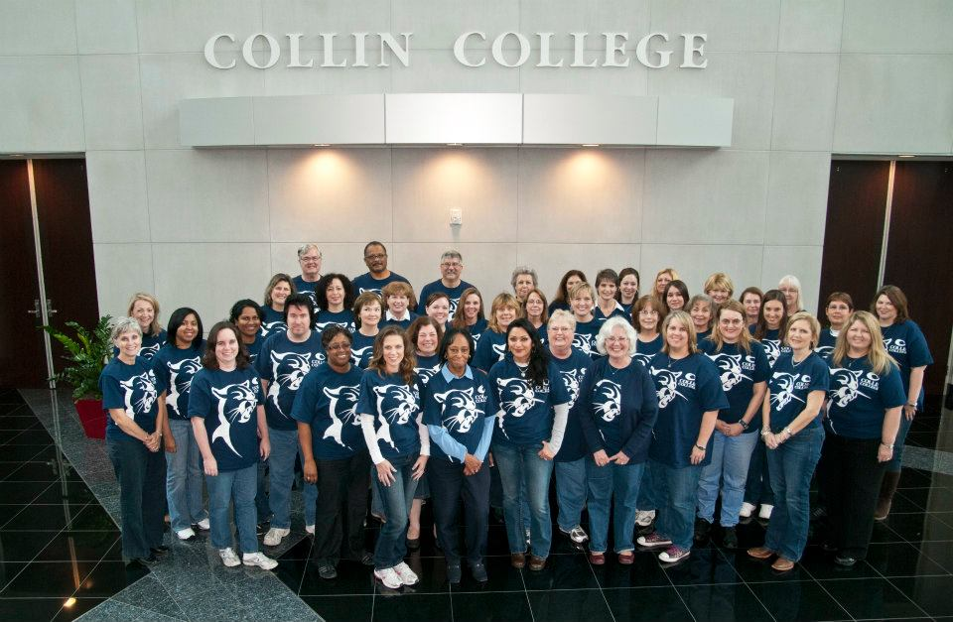
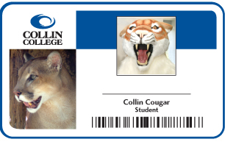
Helpful Information (cont.)
Dress Code
While we do not have a college-wide dress code policy, employees are expected to dress appropriately for the workplace. Business casual attire is generally worn by most employees. You are encouraged to discuss appropriate attire expectations for your department with your supervisor.
Employees are also encouraged to show their Cougar Pride by wearing their Collin College Spirit Shirts each Wednesday. Watch for announcements for the next opportunity to purchase your Spirit Shirt! Proceeds go to the Spirit Scholarship fund.
Employee ID Cards,
All faculty and staff of Collin College are required to have an Employee ID Card in order to use certain services provided by the college including the bookstore, computer labs, fitness center, library and college-sponsored events.
You can get your ID card in any Student Life office.

