Slide 1
Section 1
Welcome/Introductions

Slide 2
Mission of Collin College
Collin County Community College District is a student and community-centered institution committed to developing skills, strengthening character, and challenging the intellect.

Slide 3

Core Values
We have a passion for...
  Learning
  Service and Involvement
  Creativity and Innovation
  Academic Excellence
  Dignity and Respect
  Integrity

Slide 4

Accreditation
Collin College is accredited by the Southern Association of Colleges and Schools (SACS) Commission on Colleges to award associate degrees and certificates.
The Southern Association of Colleges and Schools Commission on Colleges is the regional body for the accreditation of degree-granting higher education institutions in the Southern states.
Certain programs offered by Collin College are also accredited by specialized, industry-specific accrediting bodies.

Slide 5




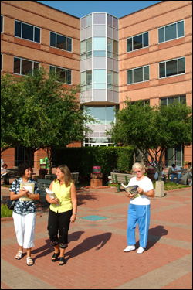


Our Campuses
Central Park Campus
2200 W. University Drive
McKinney, TX 75070
Collin Higher Education Center
3452 Spur 399
McKinney, TX 75069
Preston Ridge Campus
9700 Wade Boulevard
Frisco, TX 75035
Spring Creek Campus
2800 E. Spring Creek Pkwy
Plano, TX 75074
Courtyard Center
4800 Preston Park Blvd
Plano, TX 7507
Allen Center
300 Rivercrest Blvd
Allen, TX 75002
Rockwall Center
1050 Williams Street
Rockwall, TX 75087

Slide 6
What Makes Collin College
A Great Place To Work?
Stable Growing Organization. Since offering its first classes at area high schools in 1985, Collin College has expanded to serve about 53,000 credit and continuing education students each year. The only public college in the county, the college offers more than 100 degrees and certificates in a wide range of disciplines.
The Leadership. Collin College has great leadership, provided by experienced and knowledgeable Leadership Team members with oversight and vision provided by a 9 member Board of Trustees, which are at-large elected positions within the county.
The Employees. Collin College is a diverse organization with approximately 2500 dedicated employees. View the Personnel Headcount on the HR website for a current listing of employees by position type and campus.
The Culture. The Collin College Mission and Core Values of Learning, Service and Involvement, Creativity and Innovation, Academic Excellence, Dignity and Respect, and Integrity, were established for both students and employees. Employees exhibit Cougar Pride at all times by assisting in carrying out the mission of the college and honor the Core Values in interactions with students as well as fellow employees.
Great Benefits. Eligible full-time employees of Collin College enjoy free employee medical and dental coverage, free basic life coverage, 16 paid holidays (full-time staff), professional growth and development and much more.
Opportunity for Advancement. Collin College encourages employees to broaden their knowledge base and seek new opportunities within the college by offering professional development and tuition reimbursement programs.

Slide 7


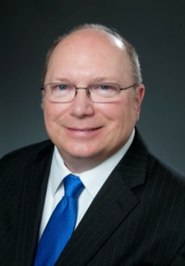



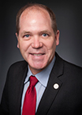
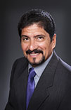

Meet The Board of Trustees
Collin College is led by a nine-member, elected Board of Trustees along with the district president.
Dr. J. Robert Collins
Chair
Founding Board Member
Stacy Anne Arias
Vice Chair
Andrew Hardin
Secretary
Nancy Wurzman
Treasurer
Mac Hendricks
Jenny McCall
Jim Orr
Adrian Rodriguez
Larry Wainwright

Slide 8
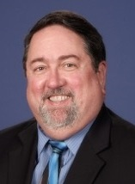
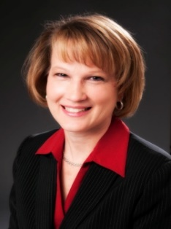
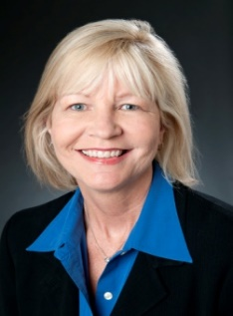
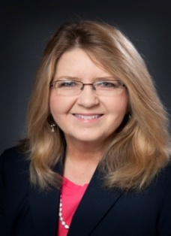
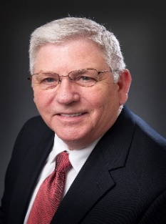

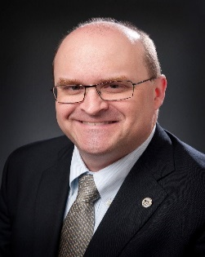
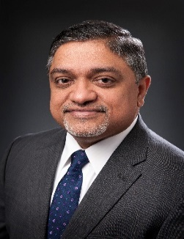
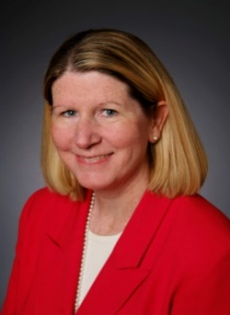

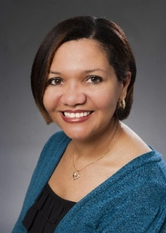
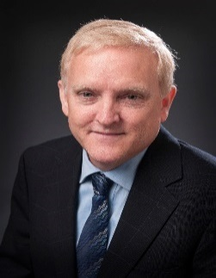
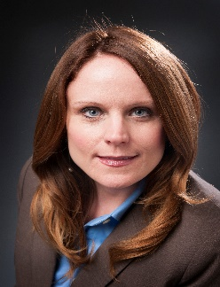
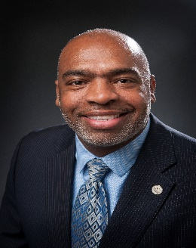
Meet the Leadership Team
Dr. H. Neil Matkin
District President
Dr. Brenda Kihl
Executive Vice President
Dr. Sherry Schumann
Senior Vice President
Academic, Workforce,
and Enrollment Services
Kim Davison
Senior Vice President,
Organizational
Effectiveness
Kenneth Lynn
Acting Vice President,
Administrative Services
and CFO
Lisa Vasquez
Vice President,
College and Public Relations
Dr. Jon Hardesty
Vice President/Provost
Central Park Campus
Dr. Abe Johnson
Vice President/Provost
Preston Ridge Campus
Dr. Mary McRae
Vice President/Provost Spring Creek Campus
Dr. Dani Day
Vice President,
Academic and Workforce Development
Norma Allen
Vice President,
Human Resources
Dr. Scott Parke
Vice President,
Policy and Planning
Jennifer Blalock
Vice President,
Workforce &
Economic Dev.
Albert Tezeno
Vice President,
Student &
Enrollment Svcs.

Slide 9
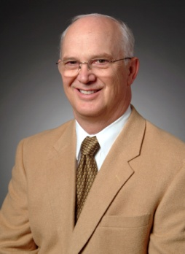

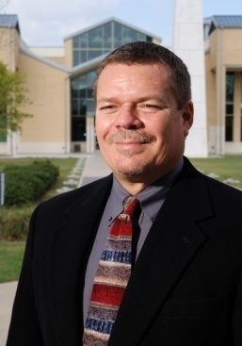
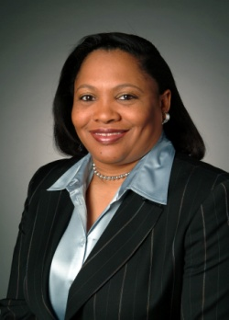
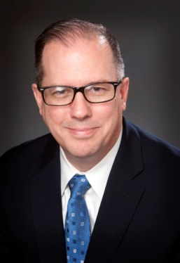
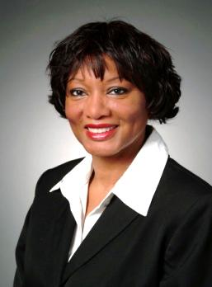
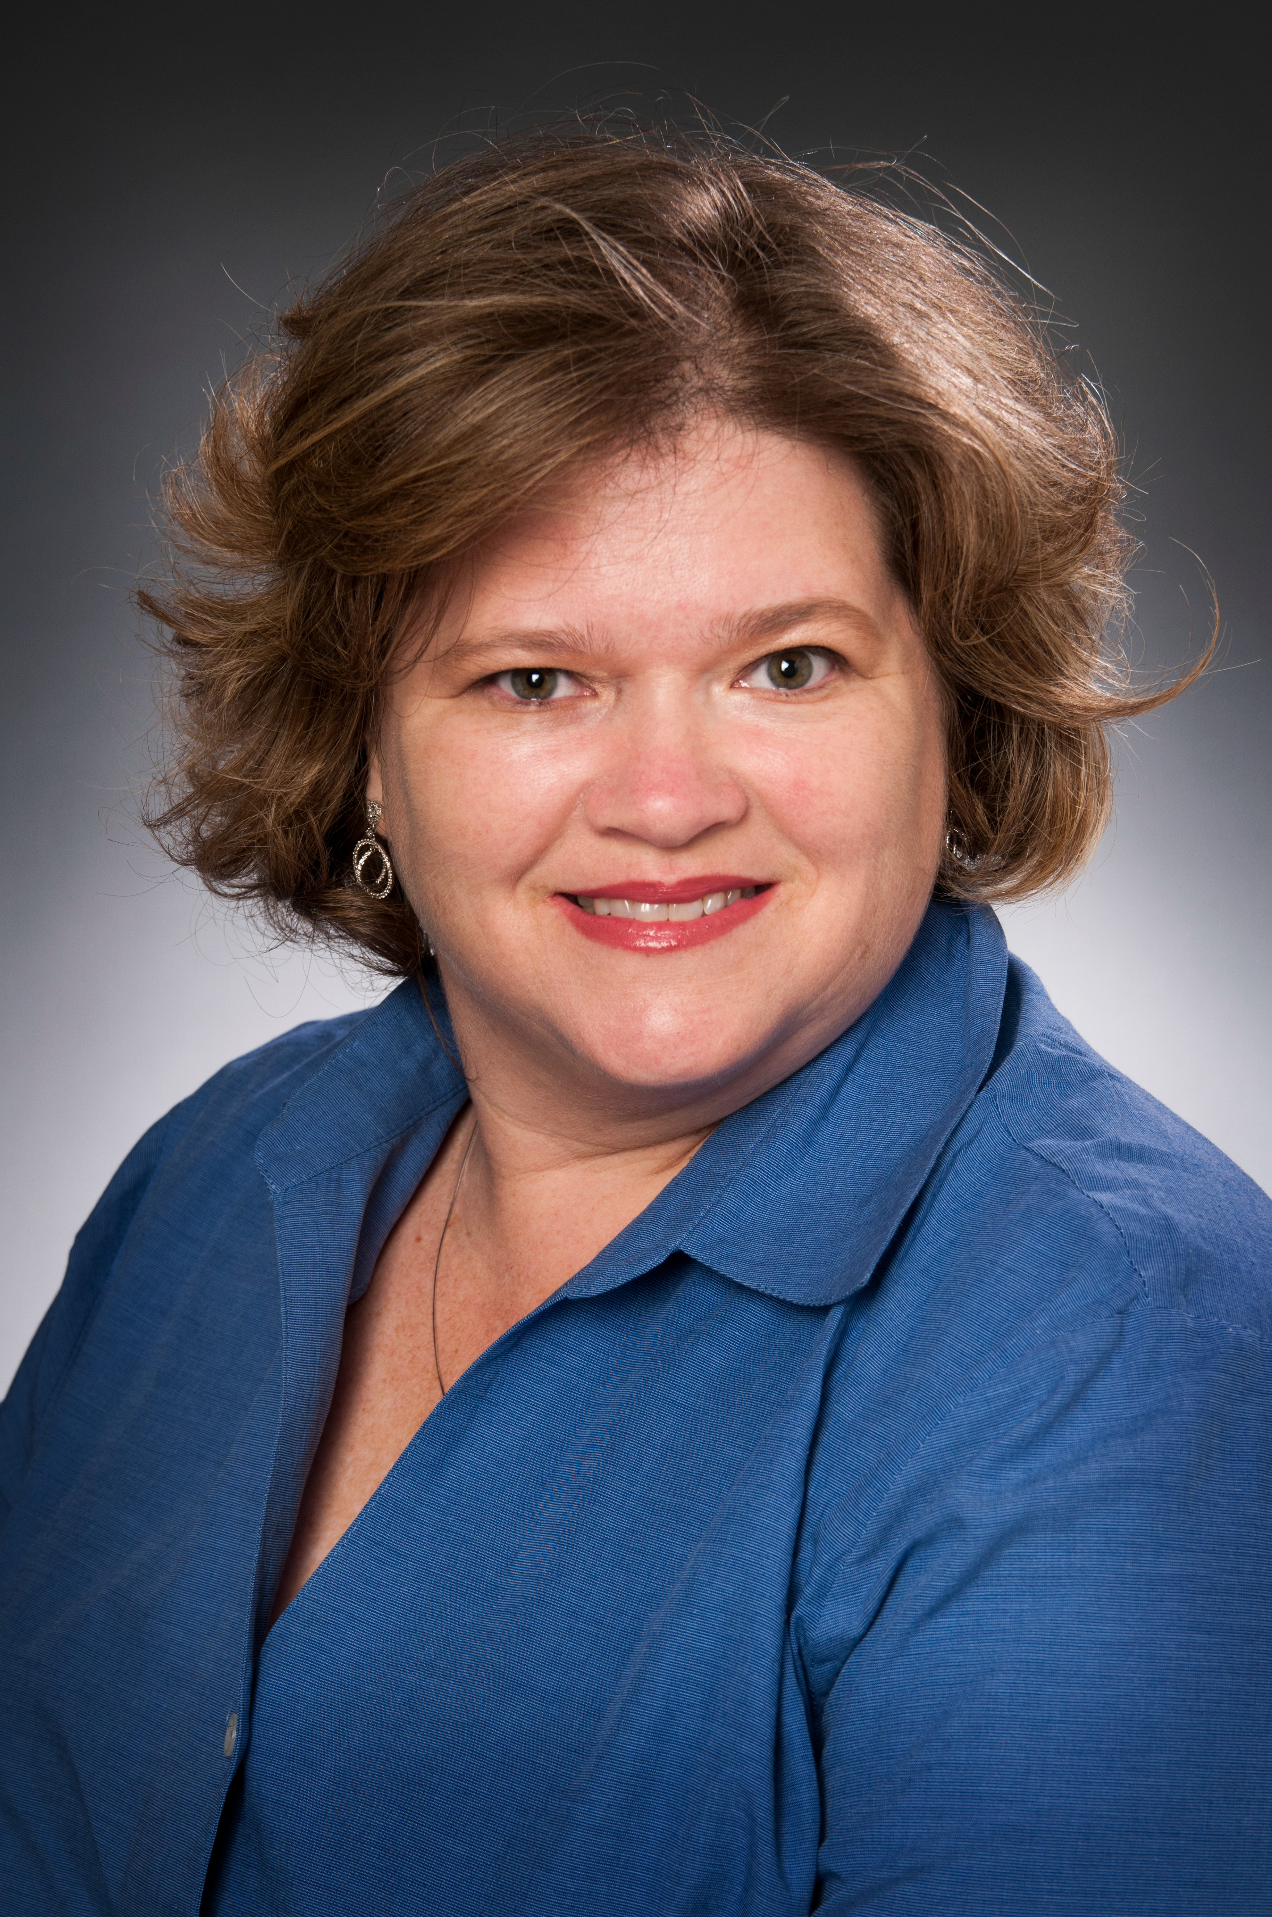
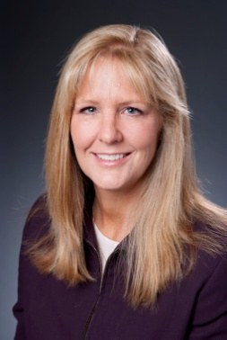
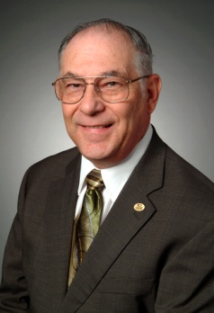

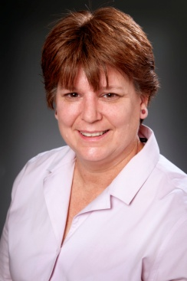
Meet the Academic Deans
Cameron Neal
Dean, Math & Natural Sciences - SCC
Donald Weasenforth
Dean, Communication & Humanities - SCC
Gary Hodge
Dean, Social & Behavioral Sciences - SCC
Gaye Cooksey
Dean, Fine Arts - District
Jim Barko
Dean, Developmental
Education - District
Brenda Carter
Dean, Academic Affairs, CPC
Michelle Millen
Interim Dean, Health Sciences - District
Donna Hatch
Dean, Nursing - District
Bill Blitt
Dean, Business & Computer Systems - District
Dawn Richardson
Interim Dean, Science,
Technology, Engineering
& Math - PRC
Wendy Gunderson
Dean, Communication, Humanities, Social &
Behavioral Sciences –
PRC

Slide 10
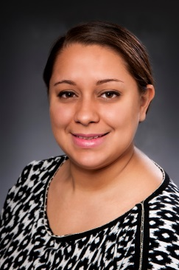
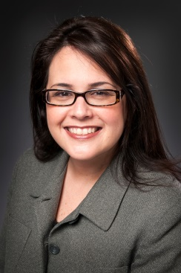

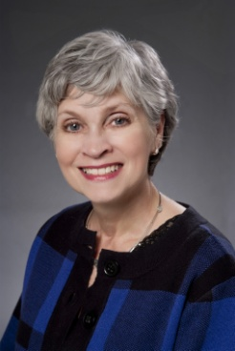
Meet Your HR Representatives
Rebecca Acuna
HR Consultant
  Spring Creek Campus
  racuna@collin.edu
  972-985-6664
Andreina Fowler
HR Consultant
  Collin Higher Education Center
  Central Park Campus
  Rockwall Center
  afowler@collin.edu
  972-599-3161
Jaslyn Lue
HR Consultant
  Preston Ridge Campus
  Allen Center
  jlue@Collin.edu
  972-758-3857
Sandy Davis
Manager, HR/Benefits
All Campuses
sdavis@collin.edu
972-599-3164
Services Provided by the
Campus HR Consultants Include:
Services Provided by the Benefits Manager Include:
Recruiting
Job Postings
Job Descriptions
New Hire Process
Review Qualifications
Calculate Salaries
HR-Related Training
Employee Relations
Performance Management
Answer HR Questions
Communicate Info
Benefits & Insurance
Retirement (ORP/TDA)
Disability Claims
Insurance Verifications
Workers’ Compensation
FMLA/Leaves of Absence

Slide 11
Section 2
Policies & Procedures

Slide 12
Policies & Procedures
Acknowledgment
It is our responsibility, as employees of the College, to become familiar with the policies that govern our conduct.
Please review the Policies & Procedures packet provided in the offer letter.
If you have questions about any of these Policies & Procedures, refer to your supervisor, or contact your campus Human Resources Consultant.

Slide 13
Policies & Procedures
Acknowledgment (cont.)
Employment Credential Deadline Policy. You agree that Collin College only accepts official transcripts submitted via one of the acceptable formats indicated on the Official Transcripts Guidelines form. Qualifying transcripts MUST be received on or before the first date of employment (but not later than 30 days from the date of hire) as well as copies of certificates, licenses, and other credentials which document employment qualification. If appropriate documentation is not received within the first 30 days, you agree that your payroll checks may be withheld pending your submission of the required documentation and/or you may be terminated from employment with Collin College. It is the employee’s responsibility to request qualifying transcripts and pay any associated transcript fees.
    For your convenience, you may use our Request for Transcript Form (In Policies & Procedures Packet).
    NOTE: Please be sure your transcripts are sent to the HR department, not Admissions.

Slide 14
Policies & Procedures
Acknowledgment (cont.)
Drug Free Schools and Communities Act. Please view the Drug Free Schools and Communities Act. Collin College supports the requirements of this Act and has provided information in the new employee packet. In addition, Collin College campuses are tobacco free. Smoking and use of tobacco products, including electronic cigarettes, is prohibited on campus, including the parking areas. You acknowledge that you have received information regarding this Act and that it is your responsibility to review the information. You agree to read the material and comply with the guidelines. You agree to contact Human Resources if you have any questions or if you do not understand the information.

Slide 15
Policies & Procedures
Acknowledgment (cont.)
HIV & AIDS. The HIV & AIDS Policy has been provided. You acknowledge that you have read information regarding Collin College’s HIV & AIDS Policies in the new employee orientation packet and that it is your responsibility to review the information. You agree to read the material and comply with the guidelines. You agree to contact Human Resources if you have questions or if you do not understand the information.
Whistle Blower Act. Please view the Whistle Blower Act. Texas Government Code prohibits retaliation against public employees who report official wrongdoing. The provision states: “a state or local government entity may not suspend or terminate the employment of, or take other adverse personnel action against a public employee who in good faith reports a violation of law by the employing governmental entity or another public employee to an appropriate law enforcement authority.” You acknowledge that you have received notification regarding your rights in this regard. For more information, call 512-463-2185, Office of the Attorney General, Texas.

Slide 16
Policies & Procedures
Acknowledgment (cont.)
Worker’s Compensation Coverage. All employees are covered by Collin College’s worker’s compensation insurance for injuries sustained in the course and scope of employment. You acknowledge that you must report an on-the-job injury to your supervisor immediately, but in no event, no more than 30 days following an injury, and you complete an injury form.
FERPA. Please view the Policies & Procedures link to learn more about FERPA. The Family Educational Rights and Privacy Act (FERPA) is the guiding force behind the provision of privacy to student records. There are many opportunities to obtain information regarding this Act and your rights and responsibilities as an employee of Collin College.

Slide 17
Policies & Procedures
Acknowledgment (cont.)
Employee Standards of Conduct Policy. The Employee Standards of Conduct Policy – DH (Local) has been provided in the Policies & Procedures packet. Please note the requirement for employees to notify their supervisor within three (3) calendar days of any arrest, indictment, conviction, no contest or guilty plea, or other adjudication of the employee for ANY felony OR any offense involving moral turpitude.

Slide 18
Agreement and Acknowledgment
Collin College Board Policies. The Online Collin College Board Policies Manual can be found at www.collin.edu/hr/ and clicking on “Board Policies Manual”.
Links to additional Important College, State and Federal Notices, as well as college policies, procedures and guidelines can be found on the HR Website. This includes Collin College Board Policies.
Agreement and Acknowledgment Form. The form is included in the Required Forms packet. Please print and sign acknowledging that you have received, or been given access to all of the referenced Collin College Faculty/Staff policies and procedures and that it is your responsibility to read, understand and abide by all such policies, procedures and guidelines. If you have questions, or do not understand any of this material, it is your responsibility to contact your supervisor or Human Resources.

Slide 19
EEO Training
Collin College is an equal opportunity employer and does not discriminate on the basis of race, color, religion, sex, national origin, age, disability or veteran status or other protected class.
Equal Employment Opportunity Information. The Collin College Equal Employment Opportunity Information as well as Board policy DAA (Legal) – Equal employment opportunity has been provided in the Policies & Procedures packet in your offer letter.
ALL employees are required to complete two on-line training courses: “Unlawful Harassment Prevention” and “EEO Laws and Discrimination Prevention”. In addition, employees who may have access to student records will also be required to complete “FERPA for Higher Education” training.
Within the first several weeks of employment, you will receive an email from Workplace Answers with a training link to the courses listed above. Please complete these online training courses by the deadline stated in the email.
Upon completion of the online training courses, a completion certification will be automatically forwarded to Human Resources.

Slide 20

Technology Agreements
Appropriate Use of Technological and Information Resources. In Collin College’s Board Policy Manual, information specific to the Appropriate Use of Technological and Information Resources can be found by typing “CR LOCAL” into the search box. For your review, a copy has been provided in the Policies & Procedures Packet.
Software and Copyright Compliance Statement and LAN Security Agreement. The statement is provided in the Policies & Procedures Packet. The LAN Agreement is included with Required Forms.

Slide 21
End of Section 2
Congratulations! You have completed Section 2 – Policies and Procedures of the New Employee Online Orientation Program.

Slide 22
SECTION 3
Benefits Information

Slide 23
Pension/Retirement
Job Not Covered by Social Security
Your earnings at Collin College ARE NOT covered by Social Security. When you retire, or if you become disabled, you may receive a pension based on earnings from this job. If you do, and you are also entitled to a benefit from Social Security based on either your own work or the work of you husband or wife, or former husband or wife, your pension may affect the amount of the Social Security benefit you receive. Your Medicare benefits, however, will not be affected. Under the Social Security law, there are two ways your Social Security benefit amount may be affected.
Form SSA-1945 and Statement Concerning Your Employment in a Job Not Covered by Social Security. (Form is included in the Required Forms packet.)
If you have any questions or concerns regarding this form, you may visit ww.socialsecurity.gov.

Slide 24
Metlife PERC plan
All part-time Collin College employees are required to participate in the Program for Extra Retirement Compensation (PERC) in lieu of Social Security (FICA).
  Mandatory program through a 403(b) tax-sheltered annuity account with MetLife in lieu of Social Security contributions
  Employee contributes 7.5% of salary pre-tax

Slide 25
Part-time Faculty Insurance
Associate Faculty members, who meet the following specific criteria (according to Texas Insurance Code 1551.1021), may elect to participate in the Texas Employees Group Benefits Program (GBP).
Eligibility:
An associate faculty member teaching credit classes at Collin College is eligible to participate in the group benefits program if the faculty member:
  Must have taught at least one course in the regular fall and spring semester in the preceding academic year,
  Have taught at least 12 semester credit hours in the preceding academic year; and
  Be scheduled to teach 12 semester credit hours in the current academic year of coverage.

Slide 26

Texas$aver
Texa$aver is a voluntary retirement savings program offered through ERS.
The recordkeeper for Texa$aver is Empower Retirement.

Slide 27


Fitness Facilities, Wellness
Fitness Facilities
There is no charge for employees to use the college’s fitness centers. Collin College ID is required.
Oak Point Center (near SCC) belongs to the City of Plano, not the college. However, Faculty and Staff can utilize the pool with an ID. Please contact the Oak Point Center at 972-941-7540 or the Physical Education Office, x5925, for hours.
Wellness Programs
Collin College’s Wellness Program is dedicated to helping employees enjoy a healthier way of life. A variety of college-sponsored wellness activities, events and information are offered to Collin College employees including blood pressure checks, fitness assessments, exercise programs and wellness seminars.
Collin College also offers a Wellness Leave Program to provide incentive and time to participate in wellness programs. Full-time faculty and staff may participate in any of the college’s sports or exercise programs and receive matched time for their exercise efforts, within the Wellness Program Guidelines.

Slide 28

Employee Discounts
Employee Discount Programs
In addition to group benefit plans and college-sponsored programs, Collin College employees also receive a number of discounts or special services on a variety of items from area businesses including:
  Credit Unions
  Banks
  Auto/Home Insurance
  Automotive
  Consumer Products
  Dining
  Education
  Electronic Equipment
  Financial Services
  Health and Wellness
  Home and Garden
  Insurance
  Local Discounts
  Travel and Entertainment
More information about these benefits can be found on the HR Website.

Slide 29

Questions?
Frequently Asked Benefit Questions: FAQs are available by visiting http://www.collin.edu/hr/benefits/faq.html.
You will be given the opportunity to ask any additional questions you may have at your HR Benefits Meeting.

Slide 30
End of Section 3
Congratulations! You have completed Section 3 – Benefits of the New Employee Online Orientation Program.

Slide 31
Section 4
Payroll Information

Slide 32

Payroll
All employees are required to have Direct Deposit. Employees may view and print their pay stubs by logging into CougarWeb.
Part-Time Staff and Student Employees
All part-time staff and student employees are paid on the last working day of the month. Part-time employees must track all hours worked in Time Clock Plus.
Part-Time Associate Faculty
Part-time associate faculty are paid based on the number of lecture and lab course contact hours taught. Please refer to the current Associate Faculty Payroll Chart in your offer letter for additional compensation information.

Slide 33
Associate Faculty
Payroll Information
Associate faculty members are paid based on the number of contact hours they are
assigned to teach and are generally limited to no more than 9 contact hours per 16-week semester. Please note, Express, Maymester and Summer terms may be limited to fewer
than 9 contact hours. Please review the Faculty Load Manual for additional information.
Teaching assignments are on a semester by semester basis and are conditioned upon
various factors including receipt of official qualifying credential documentation, sufficient
enrollment in the course and upon the schedules of full-time faculty. An offer of a teaching
assignment one semester does not guarantee subsequent assignments for future semesters.
Associate Faculty Compensation Chart & Payroll Schedule. Click on the link to view the
current compensation rates and payroll schedule for associate faculty. Please note,
compensation and payroll dates for flex entry and special assignments may differ
from what is listed on this chart.

Slide 34
Time Clock Plus
All non-exempt (hourly) employees MUST clock in and out of the college’s time clock system, Time Clock Plus (TCP), in order to track work hours.
Within the first week of employment, you and your supervisor should receive an email from the Payroll Department with TCP login information. Your CWID will be your User ID, and Payroll will issue a generic password via email for initial access to the Time Clock Plus system.
Until you receive access to TCP, please keep up with your hours on a hand written time sheet. All hours and leave will be approved on a weekly basis by your supervisor.
The TCP Payroll contact is Judy Ayres, jayres@collin.edu and phone 972-758-3824. Instructions for Time Clock Plus can be accessed through CougarWeb on the Payroll site.

Slide 35
Time Clock Plus
All exempt and non-exempt employees must also report paid leave time in Time Clock Plus (TCP). Once a new hire is set up in Time Clock Plus, an email will be sent from a Payroll Representative providing further instructions.
Please visit the Business Office/Payroll intranet page by logging into CougarWeb for additional time sheet guidelines, dates, and instructions.

Slide 36

FLSA Work Hours and Leave Guidelines
FLSA Work Hours and Leave Guidelines for Non-exempt Employees. Please view the FLSA Guidelines to learn more about the Fair Labor Standards Act (FLSA), a federal law that governs an employee's work hours and reporting requirements. This document includes instructions on how to complete a timesheet.
Note: Any adjustment to an employee’s regular work schedule, even if it does not result in a deduction of accrued leave balances, must be approved by the employee’s supervisor.
For additional FLSA information, visit: http://www.dol.gov/whd/flsa/

Slide 37
End of SECTION 4
Congratulations! you have completed SECTION 4 – Payroll of the New Employee Online Orientation Program.

Slide 38
Section 5
Faculty Information
(For Faculty only. Staff may skip to section 6)

Slide 39
Faculty Information
As an Associate Faculty you will receive correspondence in the mail inviting you to a number of Faculty Development events and workshops that will be held during the first couple weeks of the semester.
Faculty Development events may include:
  New Faculty Orientation & Introductions
  All College Day
  Faculty development conferences
  Division meetings
  Workshops on academic topics
  Class preparation, advising, mentoring and much more!
For questions about Faculty Development events, contact your Dean.

Slide 40
Required Faculty Forms
Affidavit of Primary Language. The Texas legislature enacted House Bill 638 which requires higher education institutions to aid faculty members requiring assistance to become proficient in the use of the English language. The Texas Higher Education Coordinating Board is charged with approving and monitoring the program established by each institution. One part of the compliance process is to determine whether or not English is the primary language of each teaching faculty member, tutor, teaching and laboratory assistant with responsibility for teaching academic credit courses. Employees whose primary language is not English must successfully pass an English proficiency test.

Slide 41
End of Section 5
Congratulations! You have completed Section 5 – Faculty Information of the New Employee Online Orientation Program.

Slide 42
section 6
Helpful Information

Slide 43

CougarWeb
CougarWeb is the portal into important information at Collin College. CougarWeb is used by students, faculty and staff.
The CougarWeb ‘My Workplace’ tab has employee information such as your check stub information, W2 forms, your leave balances, benefits information, college policies & procedures, calendars, forms and departmental intranet pages.
CougarWeb also provides employees of Collin College with access the college’s library databases and resources and remote access to their college email account.
For more information, log on to CougarWeb (after you have received your CWID number) or a Tutorial of CougarWeb is provided at http://www.collin.edu/cougarweb/tutorial/thingstoknow_employees_pub.html

Slide 44

Collin Mobile App
Yes! There’s an app for that!
Collin College App is available for Apple products and Google Play
Through the app, you can access:
  Calendar of events
  Map of each campus
  Class schedule
  CougarWeb and so much more!
Expect on-going enhancements!

Slide 45
Campus Security & Emergencies
The safety of our students, employees and visitors is extremely important to us. We have a number of well-trained, dedicated men and women who serve as Collin College Police Officers and Dispatchers. These individuals are all committed to making our classrooms, workplace and the community a safe place to study, work and enjoy.
The campus police are available 24/7/365.
Visit Collin College’s Police Department Website to learn more about our Police Department services, campus emergency information, campus policies and contact information.
Emergency Contact Numbers:
Call 911 if necessary.
To reach Collin College’s Police Dispatch Line:
  On-campus: Dial extension 5555
  Off-campus: Dial 972-578-5555

Slide 46

CougarAlert
When an emergency occurs, the college’s CougarAlert system can send email, text messages and voice messages to employees and students in as little as 90 seconds.
CougarAlerts will be sent in emergencies that require unscheduled closure or evacuation of a campus or the district. This includes, but is not limited to weather closures, power outages, police emergencies, catastrophes and/or hazardous exposures. CougarAlerts will not be used for promotional purposes or for scheduled closures, such as holidays.
All employees are strongly encouraged to subscribe to CougarAlert.
To subscribe, visit: http://www.collin.edu/cougaralert.html

Slide 47

Help Desk & Media Services
Help Desk
The Help Desk is available to assist employees with technology issues. The Help Desk can be reached most conveniently by dialing x6555 from any phone on campus, or by emailing HelpDesk@collin.edu.
You can also find Academic Technology and Network Services tutorials online to assist with Blackboard, CougarWeb, CougarMail, Pharos, Accessing network drives remotely/Virtual Office, Phones and Voicemail, general technology and software tutorials and much more!
You can also check out software from the Help Desk to install on your home computer if it is for work-related applications.
Media Services
Media Services staff are available at each campus to assist with classroom technology issues, requests for video equipment, laptops, projectors and much more.

Slide 48


Helpful Information
Who’s Who at Collin College
Collin College’s Organization Chart is available on the HR website.
Get Involved and “Be in the Know”
Check out the Collin College Event Calendar for upcoming college events.
Ask your supervisor, or watch for college-wide announcements about college news and events or opportunities to participate in Collin College committees, task forces or activities.
Collin College is proud of its students, faculty and staff as well as the many achievements they earn. Points of Cougar Pride highlights some recent achievements.

Slide 49

Helpful Information (cont.)
Collin College Athletics
The college nickname used by our athletic teams and other organizations throughout the college is the Collin College Cougars.
For athletic event schedules, visit: http://www.collin.edu/athletics/.

Slide 50
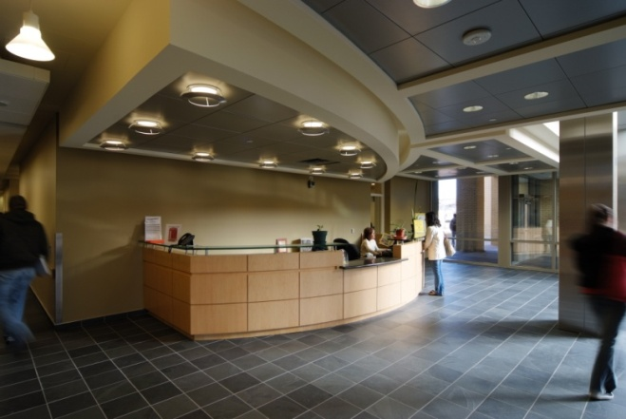
Helpful Information (cont.)
Information Desks & Room Reservations
The Information Desk at each campus can help with general inquiries, provide directions, and receive visitors and callers.
If you have a meeting scheduled, notify the Information Desk so your attendees can be directed to the appropriate location.

Slide 51
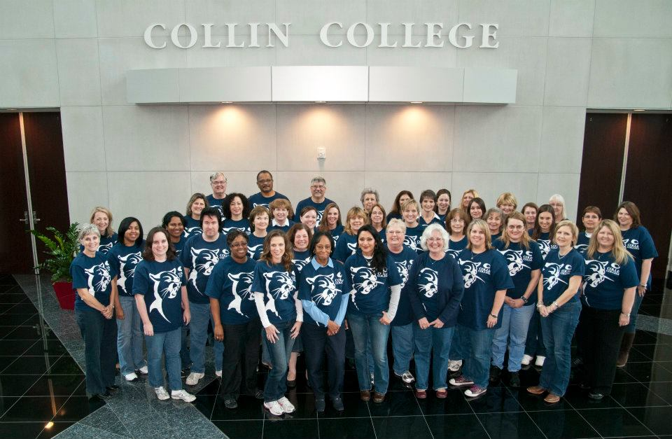
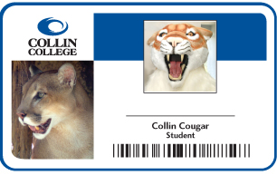
Helpful Information (cont.)
Dress Code
While we do not have a college-wide dress code policy, employees are expected to dress appropriately for the workplace. Business casual attire is generally worn by most employees. You are encouraged to discuss appropriate attire expectations for your department with your supervisor.
Employees are also encouraged to show their Cougar Pride by wearing their Collin College Spirit Shirts each Wednesday. Watch for announcements for the next opportunity to purchase your Spirit Shirt! Proceeds go to the Spirit Scholarship fund.
Employee ID Cards,
All faculty and staff of Collin College are required to have an Employee ID Card in order to use certain services provided by the college including the bookstore, computer labs, fitness center, library and college-sponsored events.
You can get your ID card in any Student Life office AFTER you have received your first paycheck.

Slide 52
Certificate of Completion
Congratulations! you have now completed all sections of the New Employee Online Orientation.
New Employee Online Orientation Certificate of Completion: This form is provided in the “Required Forms” packet. Please print and complete this form and bring the form with you to your scheduled benefits meeting on your first day of employment.
REMINDER:
Please ensure you have printed and completed all required forms listed on your Online Orientation Checklist in the Required Forms packet. You will need to bring the following items with you on or before your first day of employment:
  Online Orientation Checklist (and all associated forms listed on the checklist)
  I-9 Identification and Work Authorization Documentation
  Social Security Card (for payroll purposes)

